Slide 1
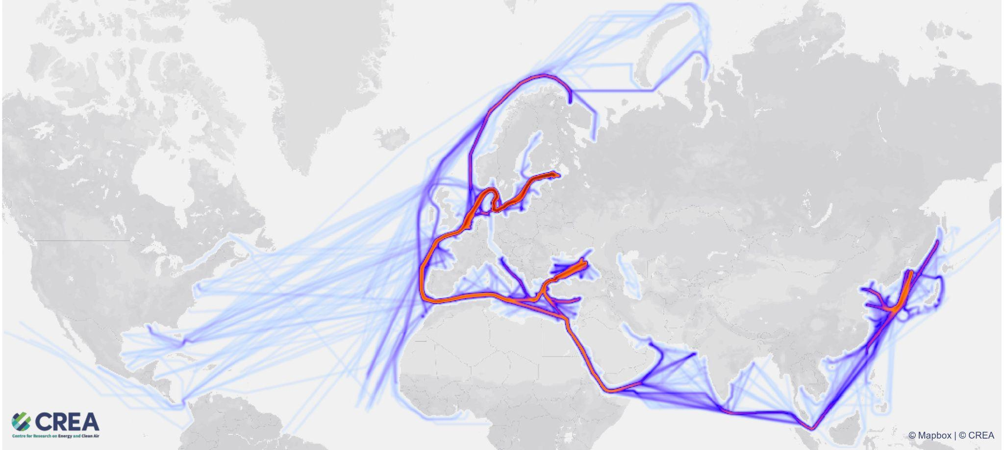
Financing Putin’s war: Fossil fuel exports from Russia in the first six months of the invasion of Ukraine
Andrei Ilas, analyst

Slide 2
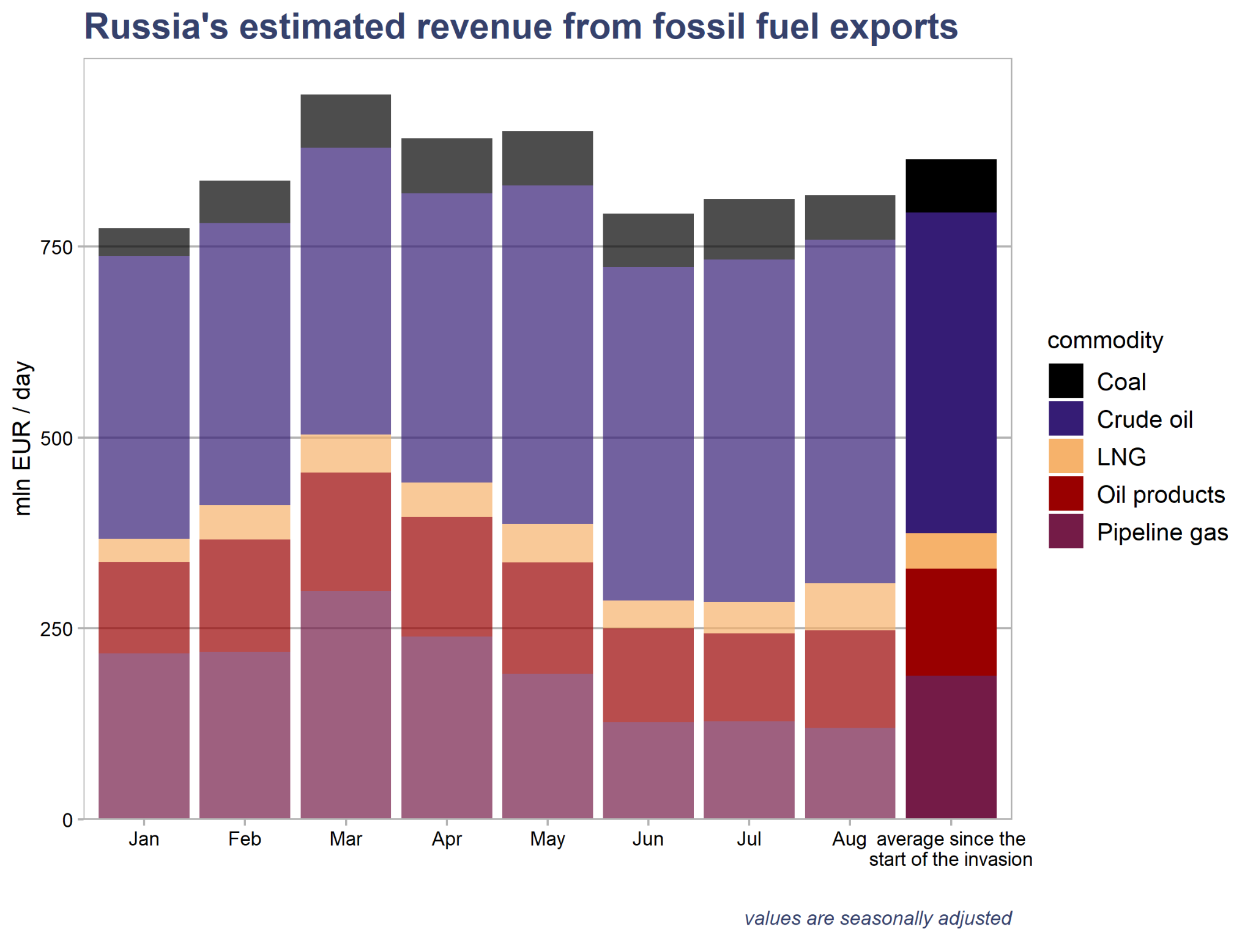
Russia earned EUR 158 billion in revenue from fossil fuel exports since the war started
Russia earned EUR 158 billion in revenue from fossil fuel exports in the first six months of the war (February 24 to August 24).
The EU imported 54% of this, worth approximately EUR 85 billion.
Fossil fuel exports have contributed approximately EUR 43 billion to Russia’s federal budget since the start of the invasion.

Slide 3
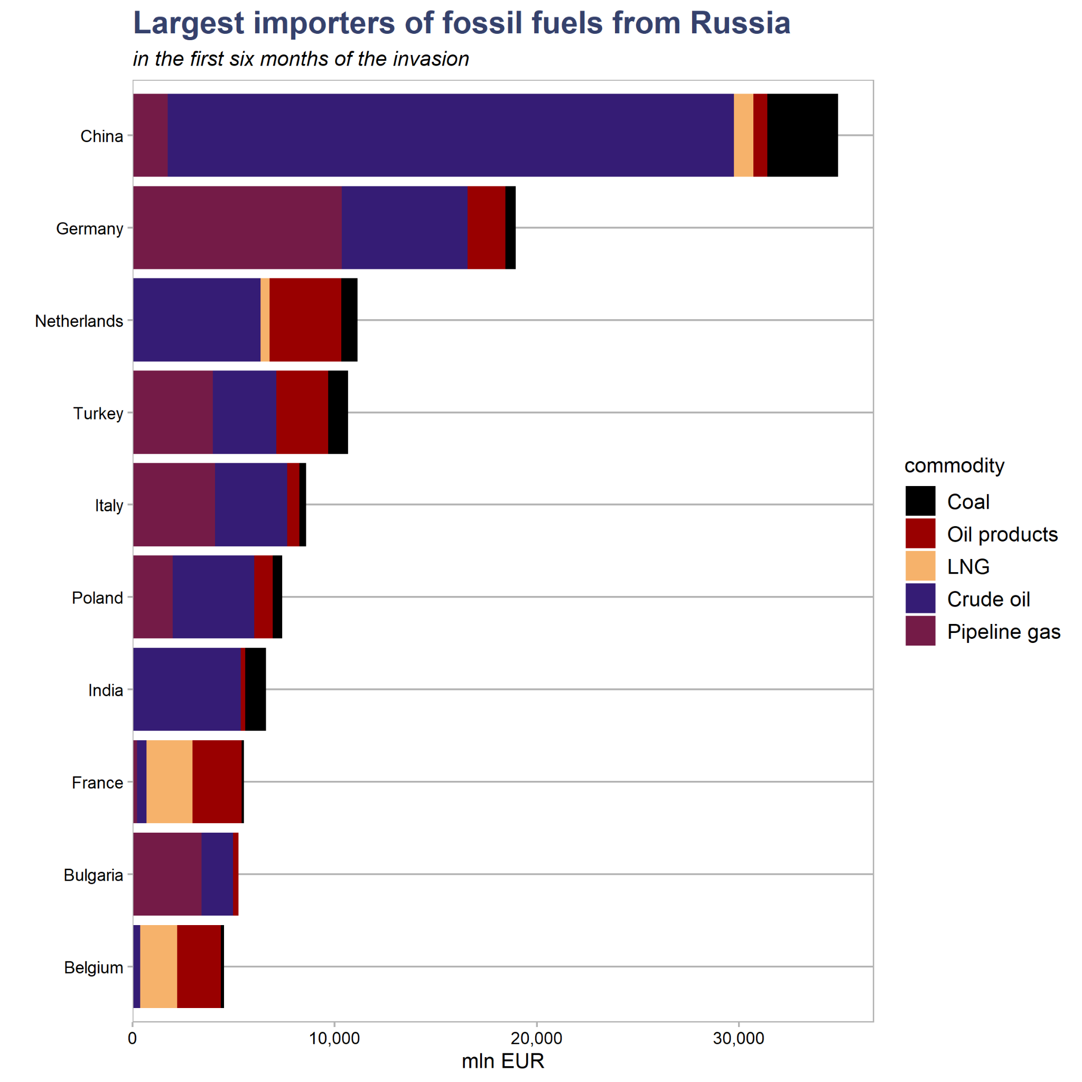
China has become the largest importer of Russian fossil fuel as Germany stepped back
After the EU, the largest fossil fuel importers were China (EUR34.9bln), Turkey (EUR10.7bln), India (EUR6.6bln), Japan (EUR2.5bln), Egypt (EUR2.3bln, and South Korea (EUR2bln).
Within the EU, the largest importers were Germany (EUR19bln), Netherlands (EUR11.1bln), Italy (EUR8.6bln), Poland (EUR7.4bln), France (EUR5.5bln), Bulgaria (EUR5.2bln), Belgium (EUR4.5bln), and Spain (EUR3.3bln).

Slide 4
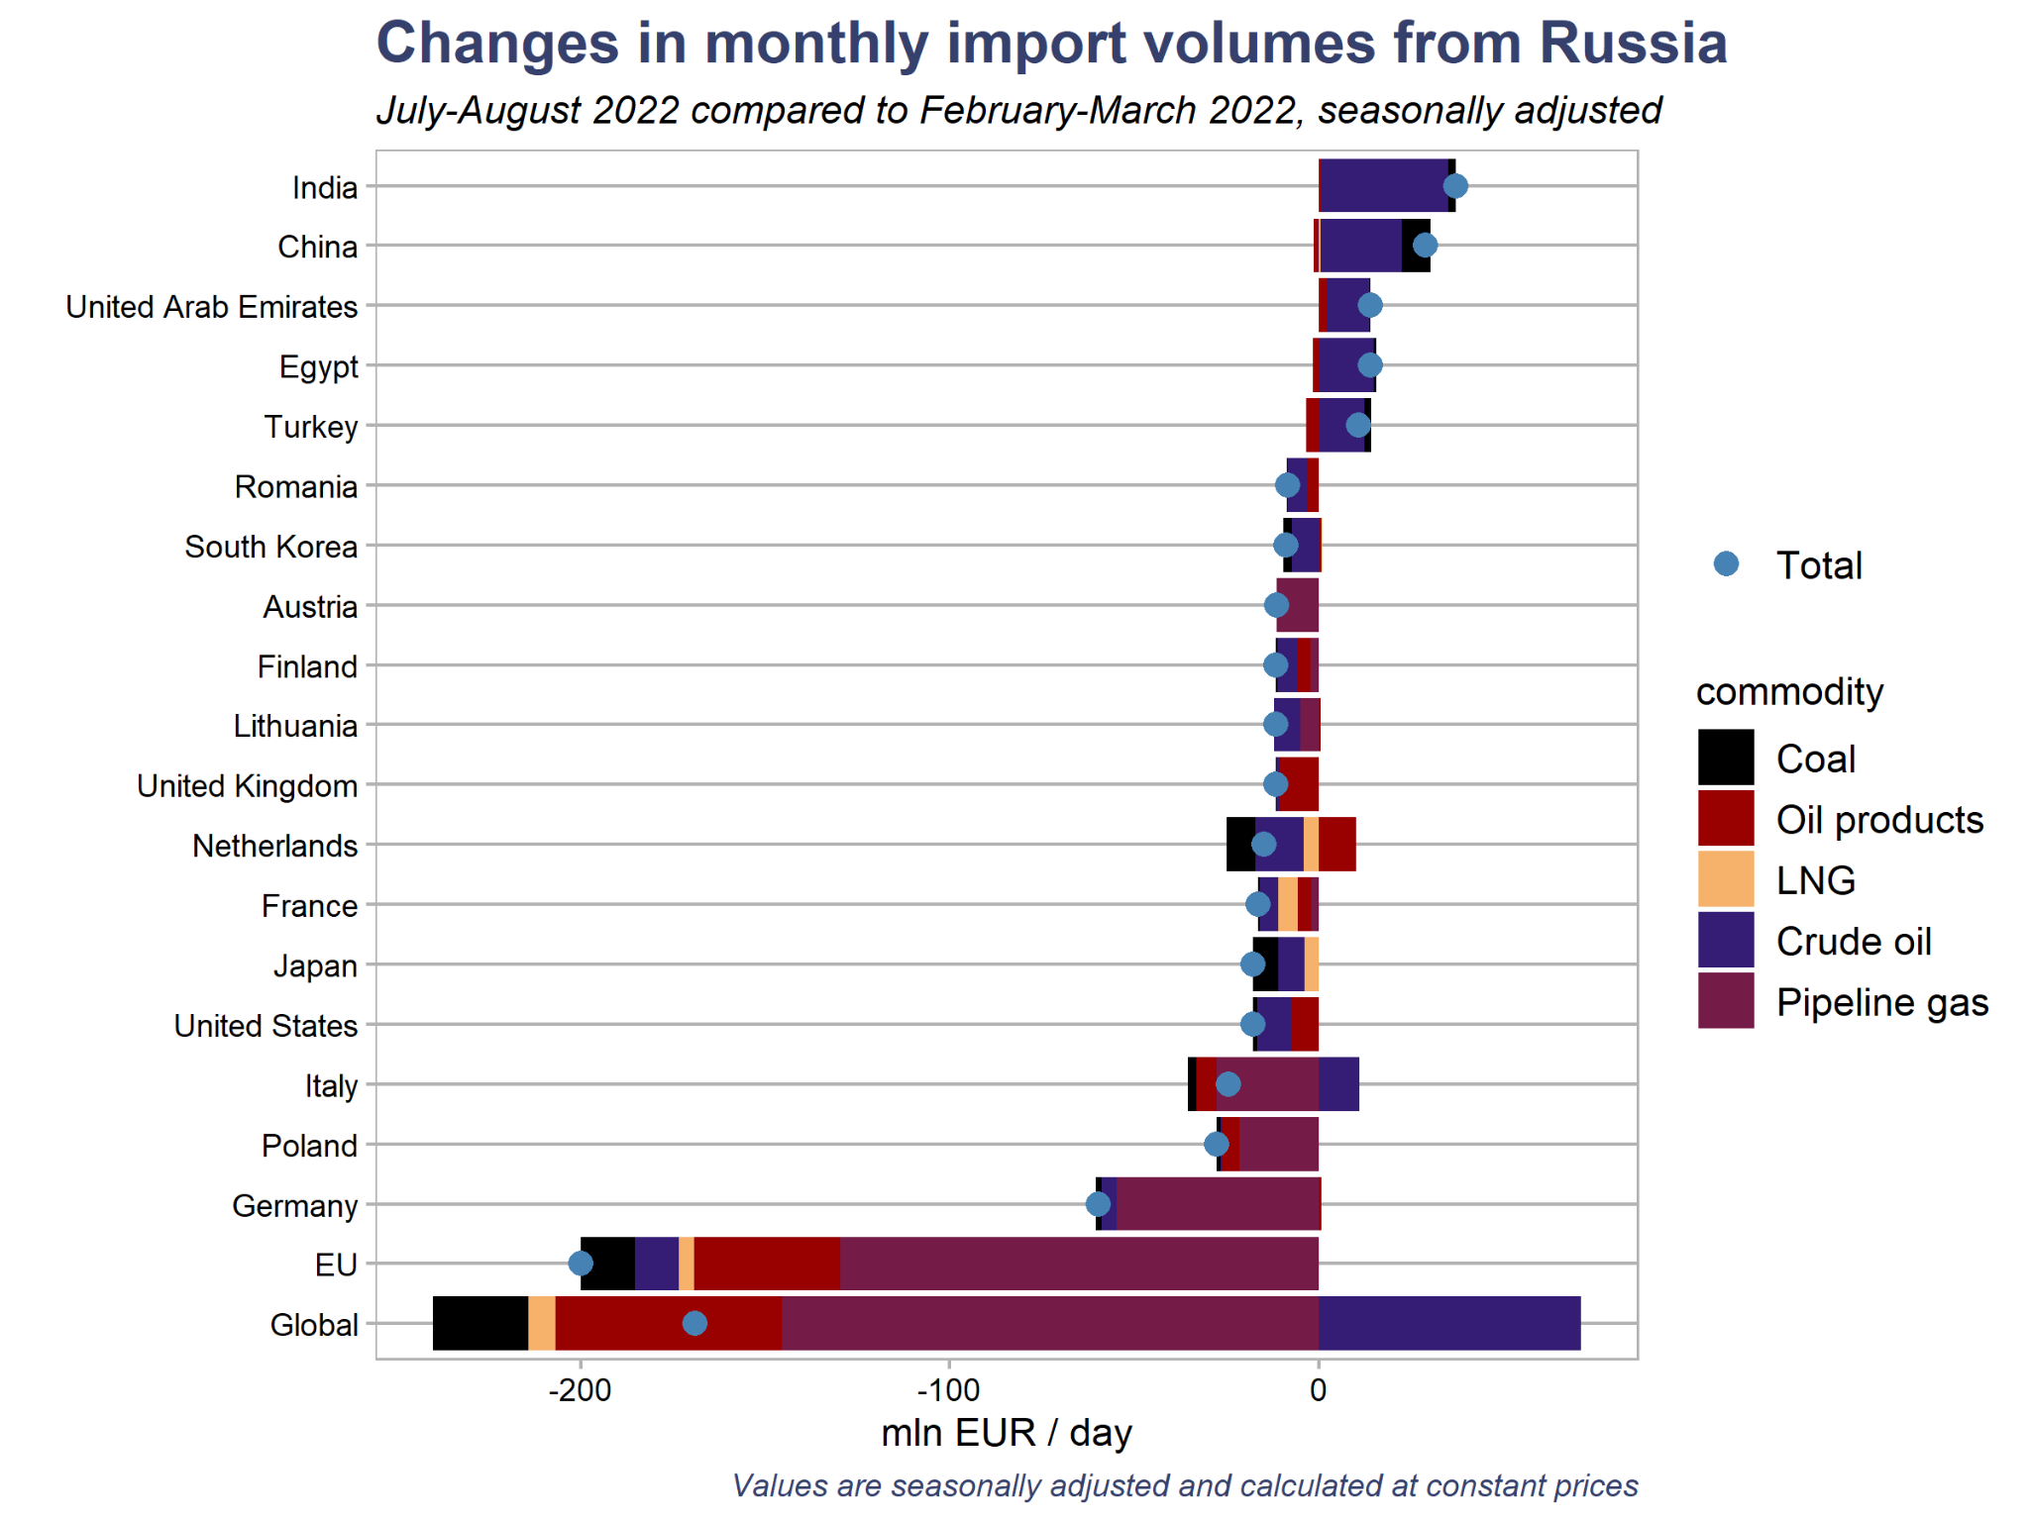
Fossil fuel exports are down from the peak at the start of the invasion
The value of exports fell by 18% in July-August, compared with February-March, on a seasonally adjusted basis. Exports to the EU fell 35%.
Compared with the start of the invasion, the reductions in imports of Russian fossil fuels cost the country EUR 170 million per day in lost revenue in July and August.
India, China, the United Arab Emirates, and Egypt saw the most significant increases in imports in July-August, compared with the start of the invasion.

Slide 5
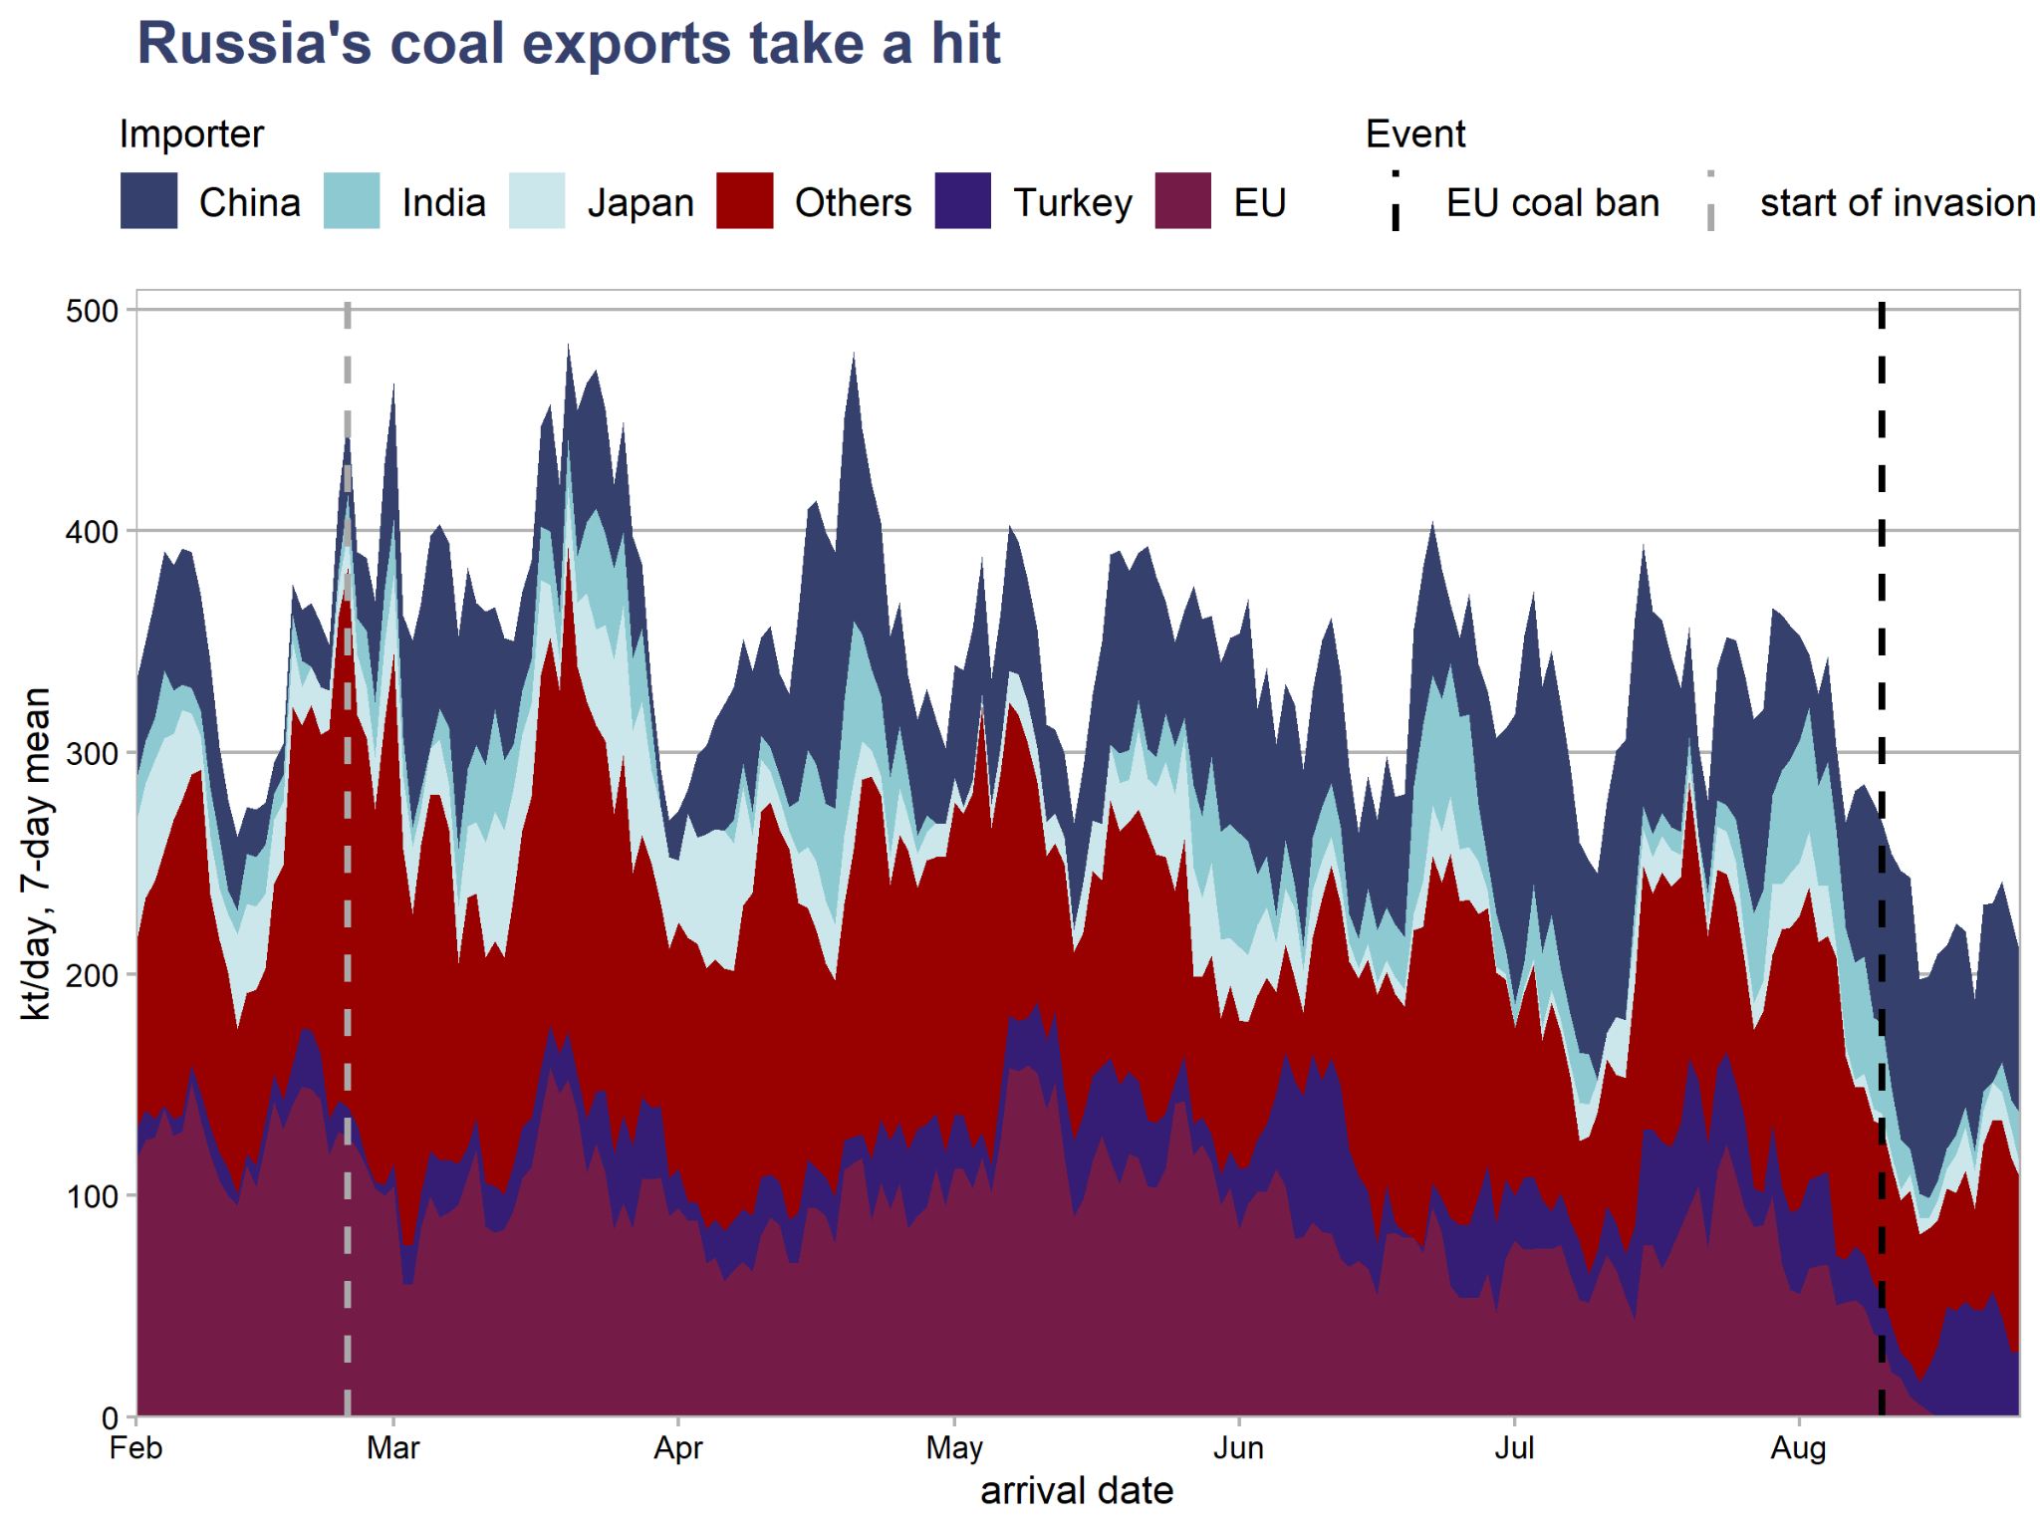
Coal ban has been effective in slashing Russia’s exports
After the EU coal ban entered into force on August 10, Russia's coal export volumes fell to the lowest level since the start of the invasion.
Russia failed to find other buyers to replace demand from the EU, although the ban has been public knowledge for months.
In the weeks after the coal ban, there have been no notable increases in shipment to any other country.

Slide 6
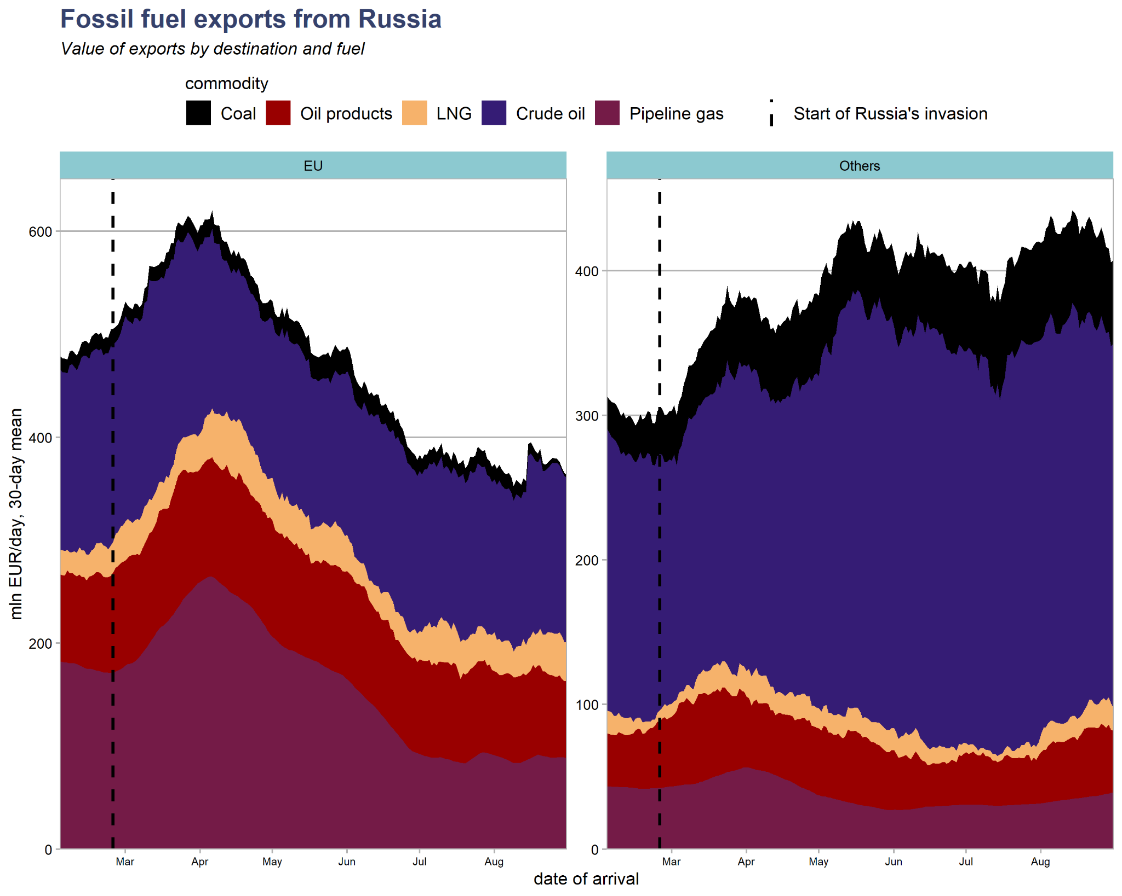
Revenue rebounded from June to August
EU imports stabilized after a fall from March to June
Exports outside the EU continued to climb
Russia’s pricing power increased — global prices increased and discount on Russian oil narrowed

Slide 7
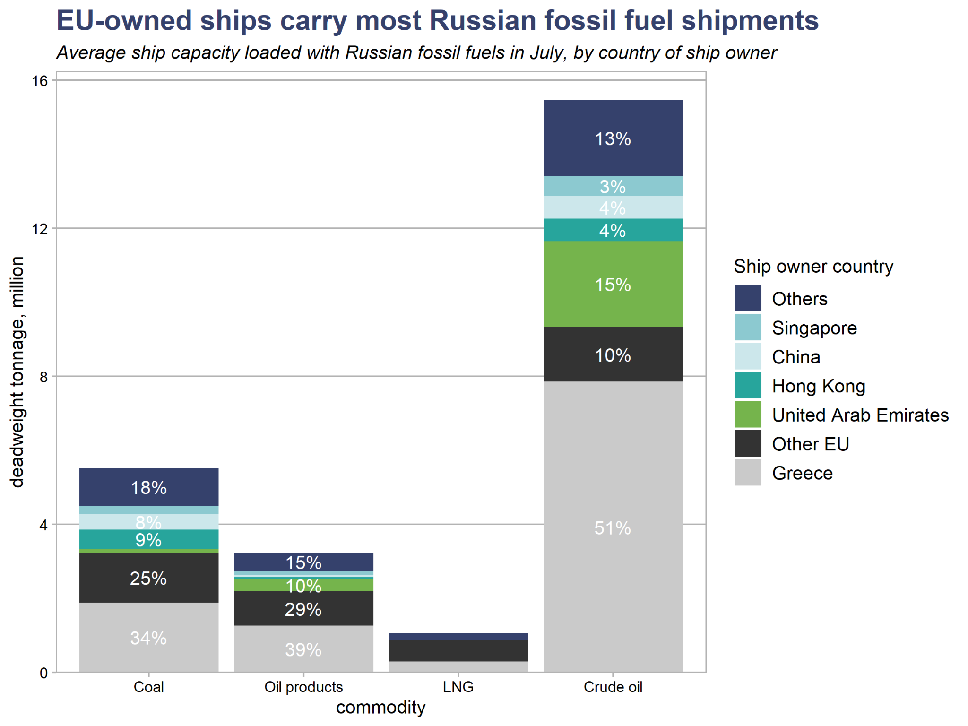
Implementing the oil price cap: Europe has the tools
Out of ship capacity carrying Russian fossil fuels in July
  62% was owned by EU shipping companies
  73% was insured in the UK and Norway

Slide 8
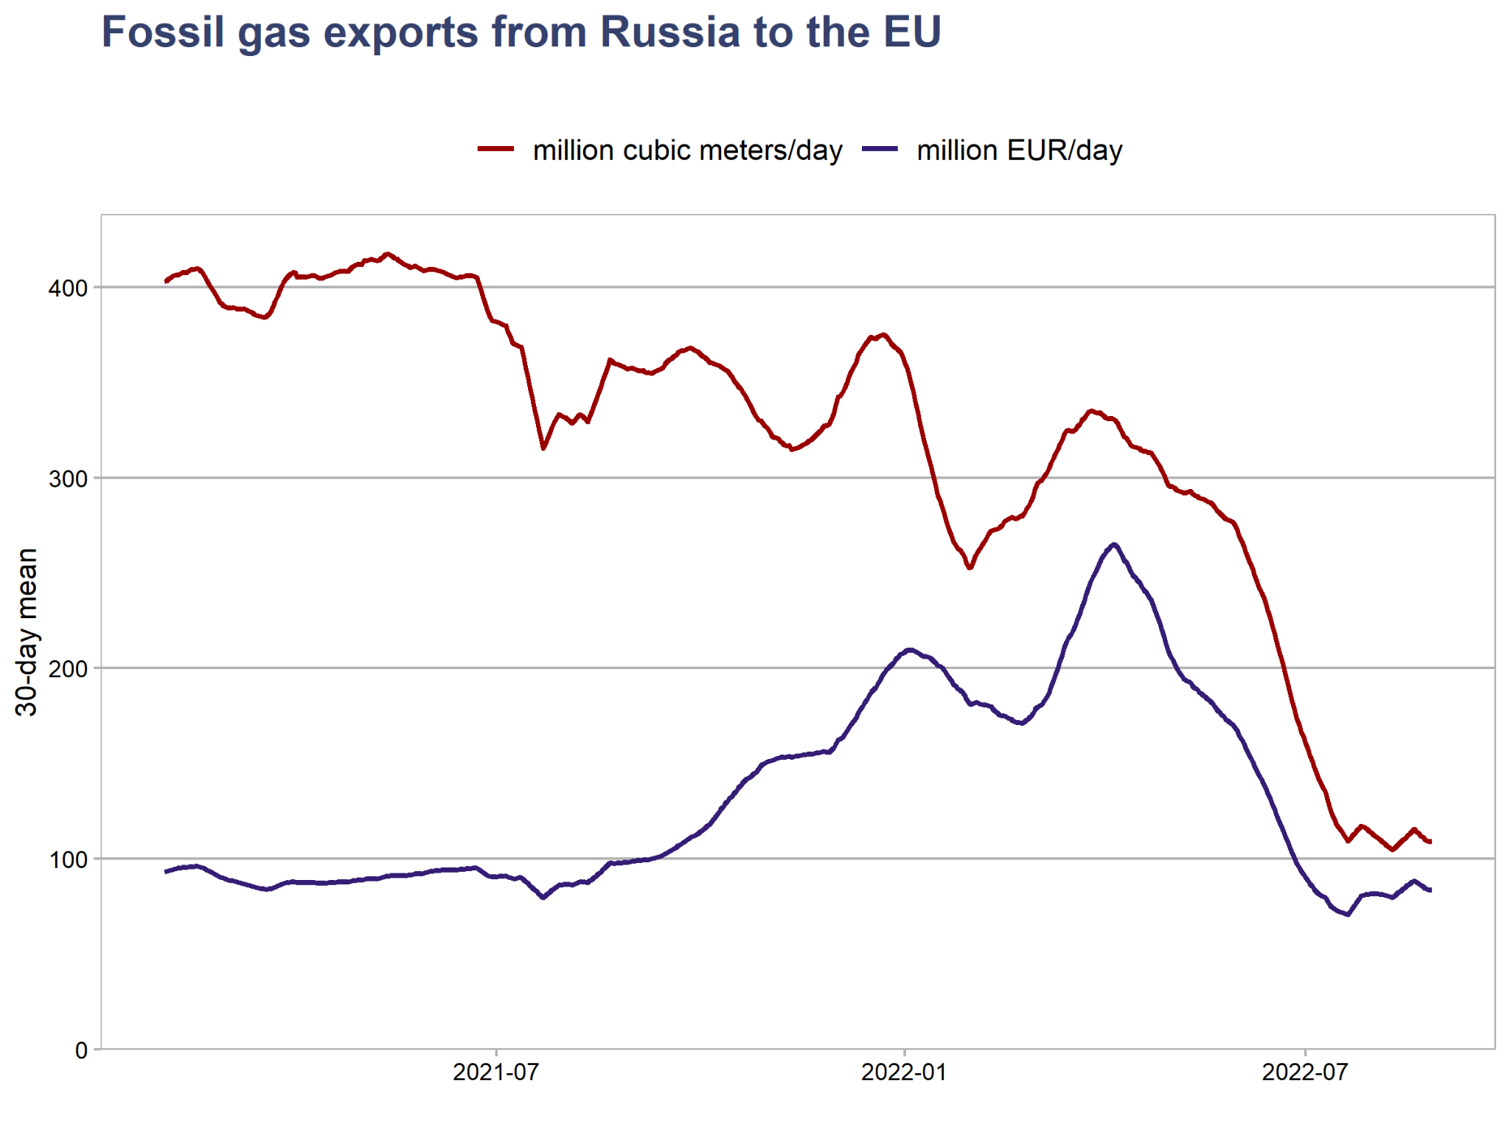
Action on gas import prices needed too: Russia’s gas blackmail is rewarded by EU market mechanisms
Russia has dramatically cut gas flows to the EU by three fourths since the first half of 2022, in violation of existing contracts.
Prices paid to Russia for gas are linked to prices on Europe’s internal market.
As a result, prices have skyrocketed and Russia is making as much money on gas exports now as in the first half of 2021.
  Pattern repeated this morning!
Europe needs to decouple prices paid to Russia from internal prices.

Slide 9
Policy Recommendations
Slash oil and gas prices paid to Russia with price caps, high import tariffs and/or shipping charges.
  Including prices paid by third countries
Implement short-term energy-saving measures such as lowering indoor temperatures in public buildings, offering cash incentives to consumers to reduce consumption, rationing gas to industrial users, lowering speed limits and cutting the prices of public transport.
Avert a subsidy price war for gas. Support the incomes of vulnerable groups, instead of supporting fossil fuel consumption which only drives up prices further.
Accelerate the deployment of clean energy, heat pumps, electric vehicles, and other technologies that can replace Russian fossil fuels over the next years.

Slide 10
Thank you!

Slide 11
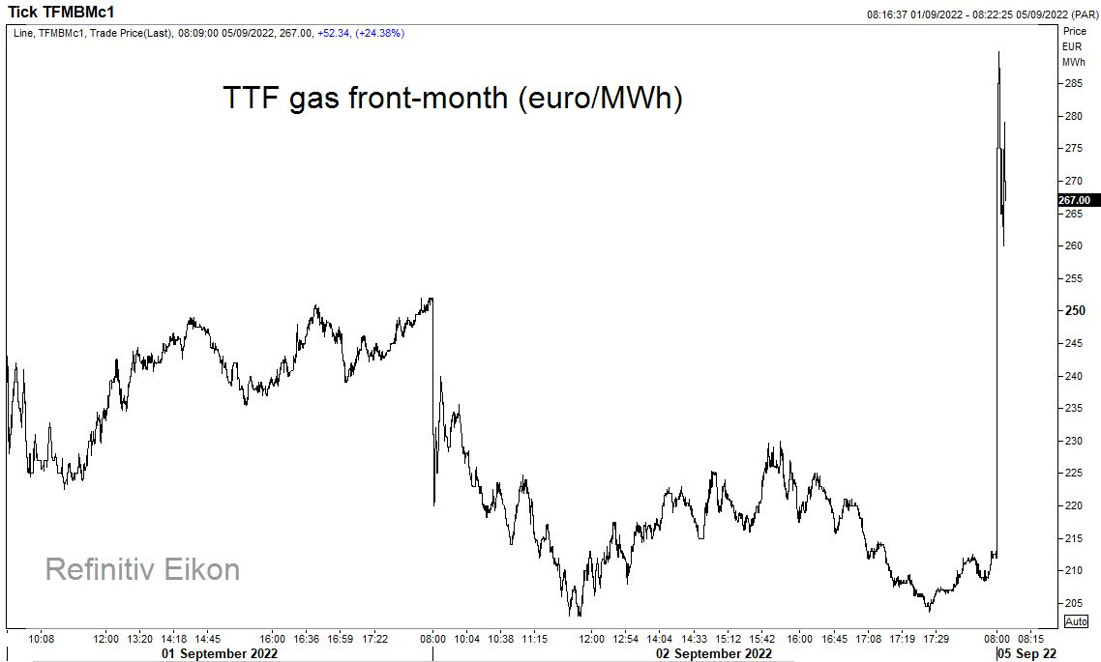
This morning: Europe’s reward to Putin for the decision to shut down Nord Stream 1

Slide 12
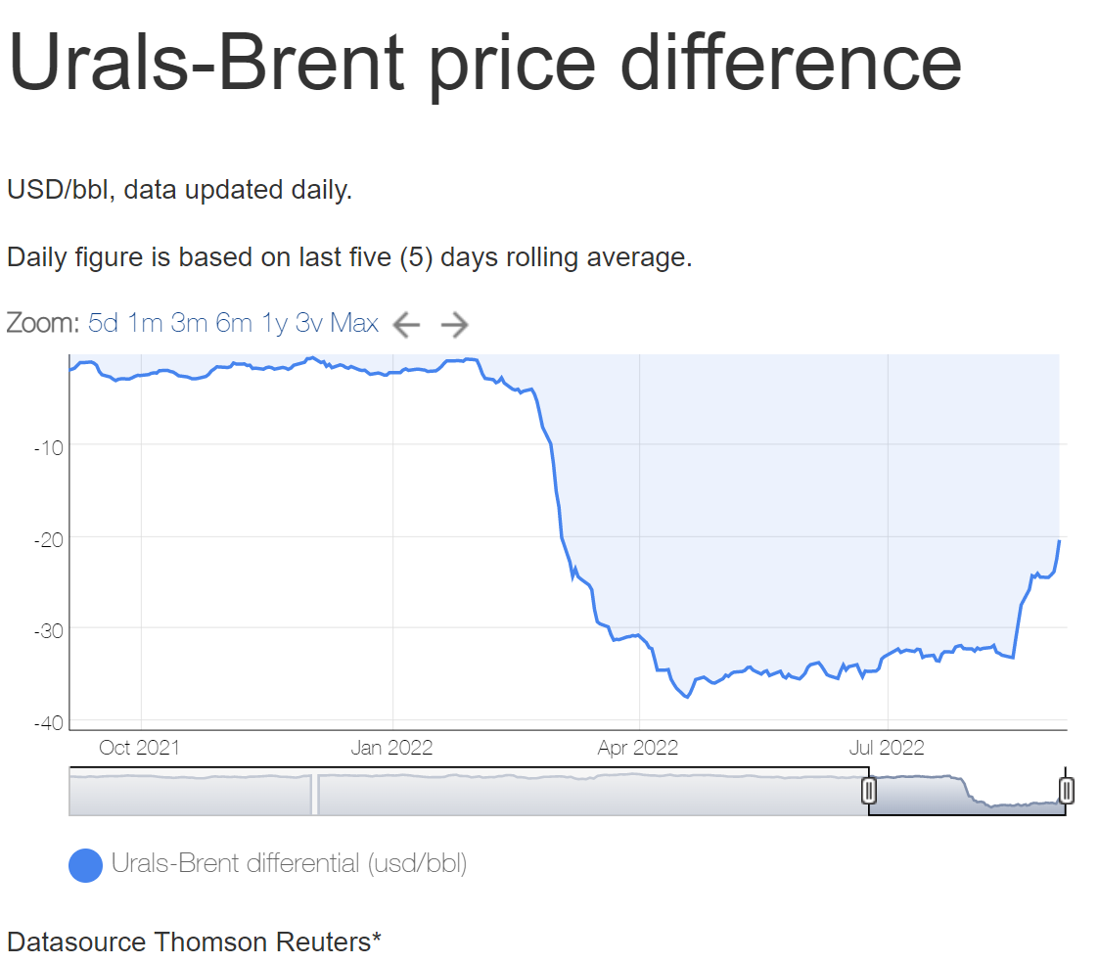

Slide 13
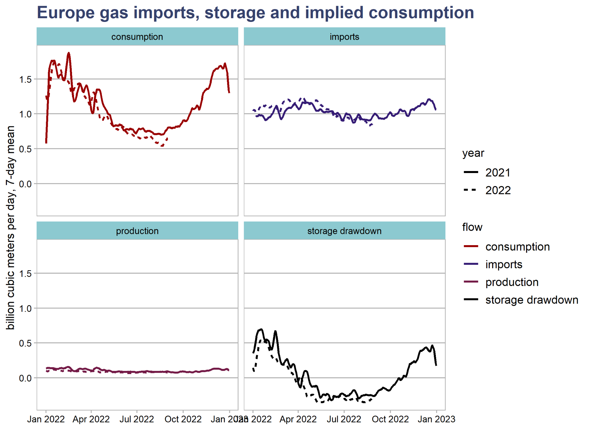
Gas demand begins to react

Slide 14
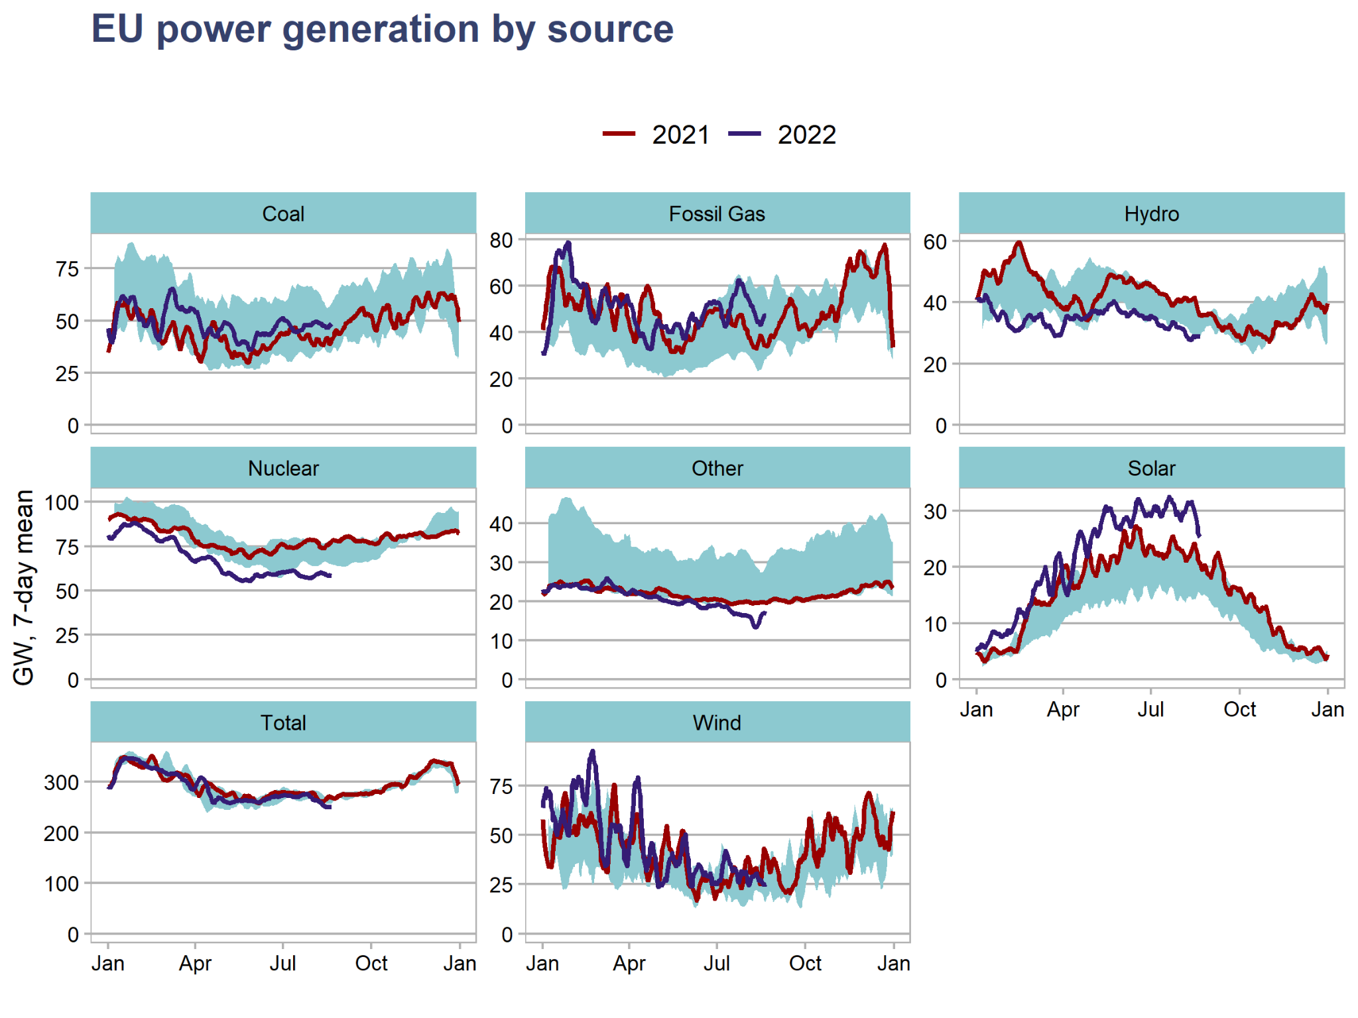
Gas-fired power generation still up due to weak nuclear&hydro

Slide 15
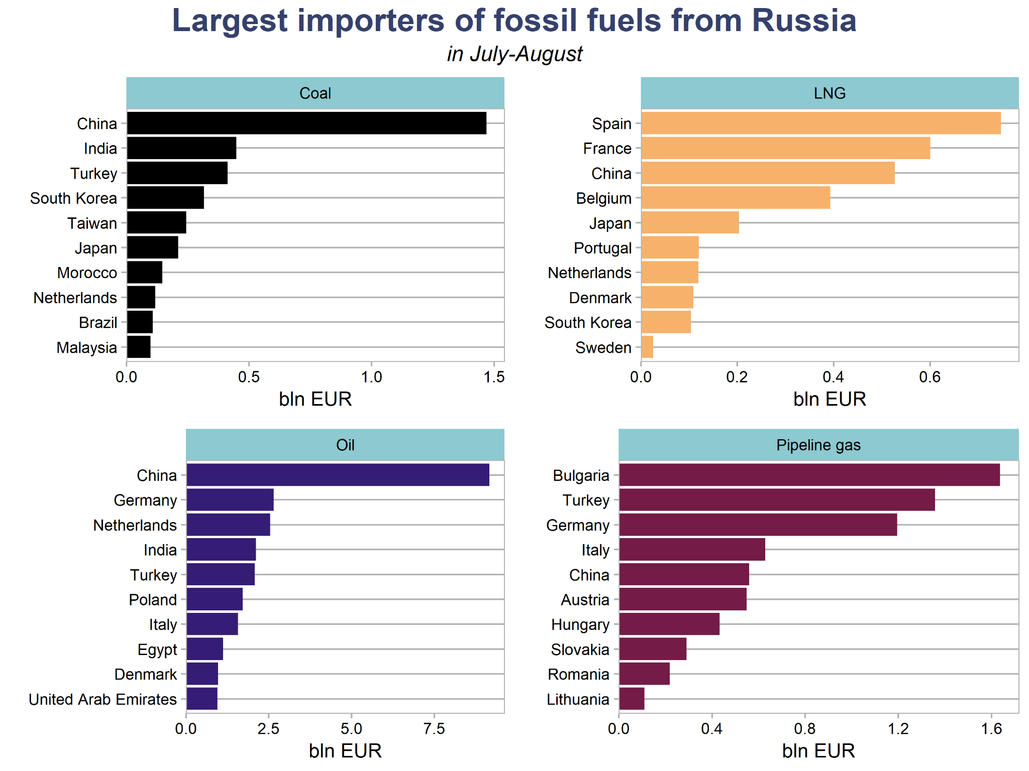
Spain gas price subsidy case study
Spain was the largest importer of Russian LNG in July-August, up from, third place in earlier months

