Slide 1

Green Hydrogen
Application to Innovation Fund

Slide 2
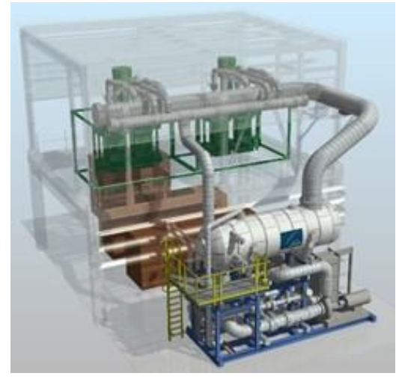
Green Hydrogen
Three “colors”of hydrogen: grey, blue, green. The desirable one is: green hydrogen.
Technology: water electrolysis using green energy.
EU strategy: three phases
  2020-2024: min 60GW electrolyzers – about 1 mil tonnes H2;
  2025-2030: min 40GW - about 10 mil tonnes H2;
  2030-2050: about 25% of total renewable capacity to be used for H2 production
Current H2 demand in Romania: 185 000 tonnes/year

Slide 3
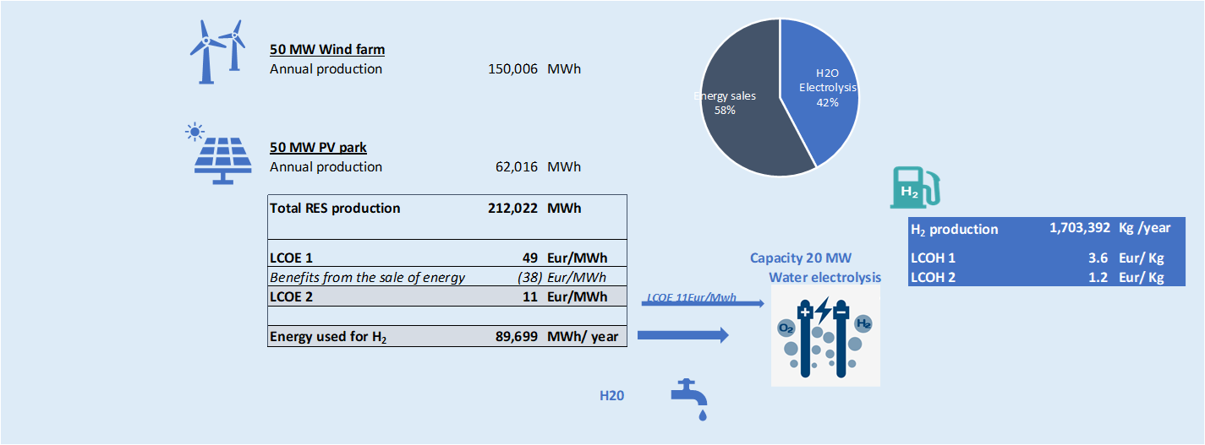
Technical Solution
Peak shaving from 50MW wind and 50MW PV, for a 20MW electrolyzer – resulting about 4500 h/year nominal equivalent

Slide 4
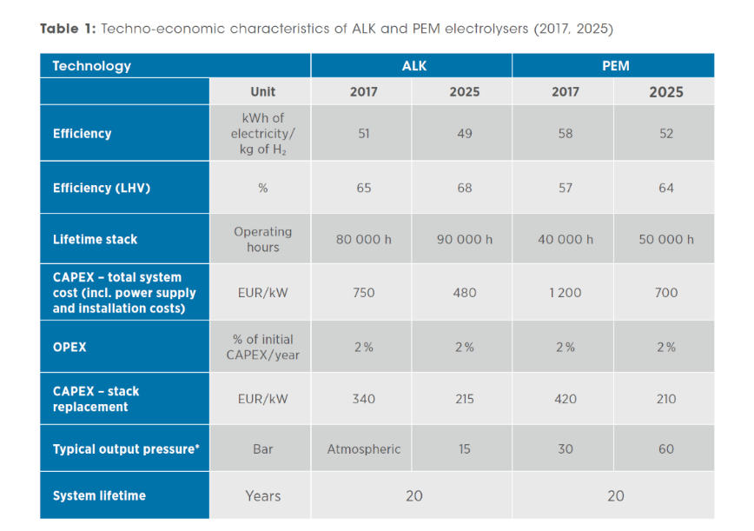
Electrolyzer Technology
It was selected PEM technology as it is more flexible and more adapted to the variable characteristic production from renewable energy
Downside of PEM: more expensive – need for subsidies

Slide 5
Operations
Output type | Unit | Volume
Wind energy | MWh | 150,006
PV energy | MWh | 62,016
Total Renewable Energy | MWh | 212,022
of which
Renewable Energy sold | MWh | 138,278
Used in electrolysis process |  | 89,699
Green Hydrogen produced | Kg H2 | 1,703,392
The green H2 becomes competitive with the grey H2
Storage designed for 8h of nominal H2 production

Slide 6
Use of Green H2
Before storage: injection in the gas transport network
After storage:
  Green electricity production
  Green chemical products
  H2 mobility

Slide 7
THANK YOU
doru.voicu@renovatiotrading.ro

