Slide 1
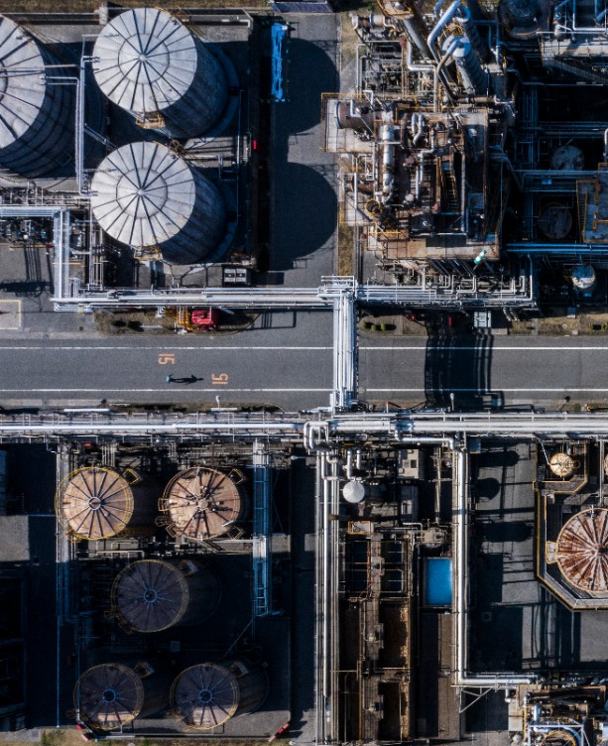
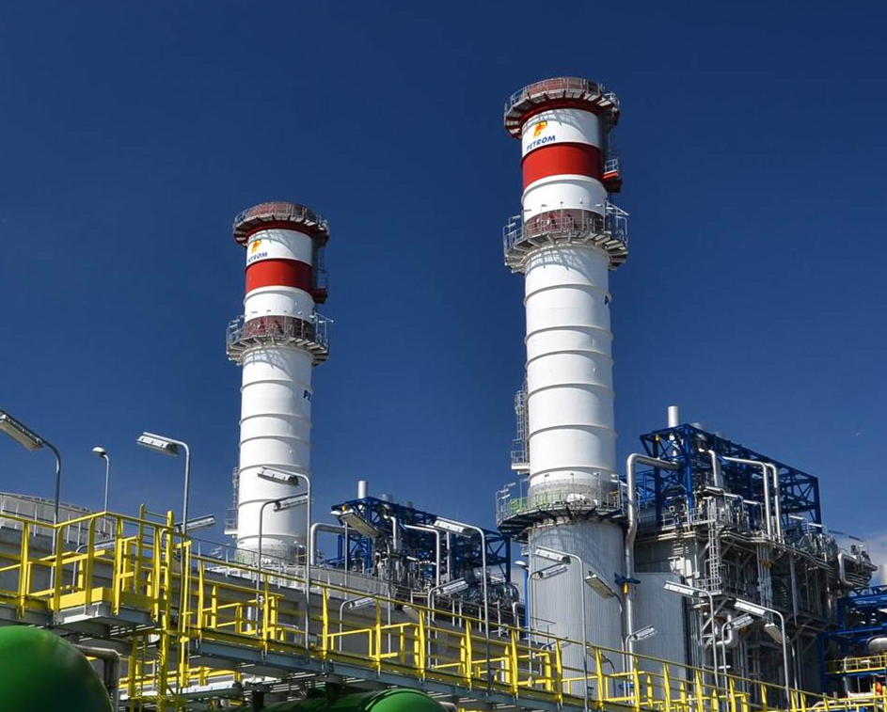
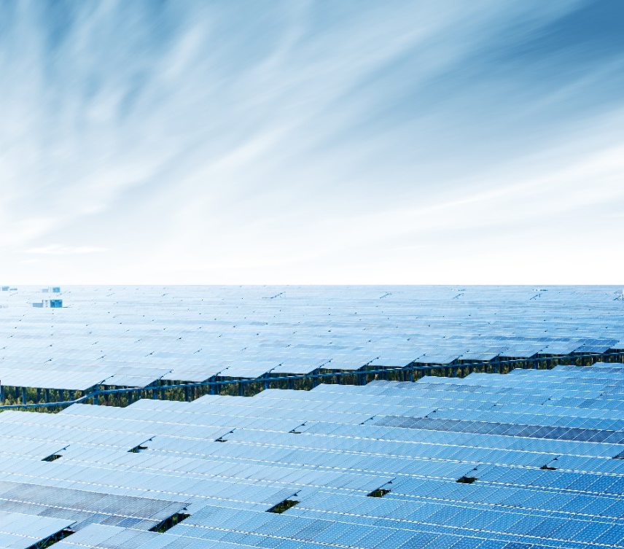

COMPLEXUL ENERGETIC OLTENIA PRESENTATION
- PLANNED DEVELOPMENT OF CE OLTENIA -
September 2022

Slide 2
Overview of Complexul Energetic Oltenia (CE Oltenia)
LIGNITE PRODUCTION
9 mining pits in Gorj & Mehedinți
ELECTRICITY PRODUCTION
Total installed capacity 3570 MW
- TPP Rovinari: 1,320 MW (4 x 330 MW)
TPP Turceni: 1,320 MW (4 x 330 MW)
TPP Ișalnița: 630 MW (2 x 315 MW)
TPP Craiova: 300 MW (2 x 150 MW cogeneration)
All plants are authorised in terms of environmental protection
THERMAL ENERGY PRODUCTION
It offers thermal energy to the city of Craiova for ~200,000 inhabitants
Average annual production 700,000 Gcal
The projected market share for coal-fired electricity production under the Integrated National Energy and Climate Change Plan (INECP) varies from 17.5 TWh in 2020 (25% market share) to 11.9 TWh in 2030 (15% market share), or 18-20% as the market share of CE Oltenia
Main shareholders:
The Romanian State represented by the Ministry of Economy, Energy and Business Environment - 77%
Fondul Proprietatea S.A. – 22%
MARKET SHARE IN ELECTRICITY PRODUCTION IN ROMANIA 2020
  Nuclear
  20,78%
Market share of
CE OLTENIA
16.5%
  Hydro
  29,01%
  16,55%
  Coal
  0,0%
  0,2%
  HFO
  1,5%
  Biomass
  Solar
  13,63%
  18,17%
  Wind
  Gas
KEY INDICATORS | 2017 | 2018 | 2019 | 2020 | 2021est
Electricity sales [ths. EUR] | 559,534 | 538,835 | 577,595 | 363,096 | 581,522
Gross profit [ths. EUR] | 61,681 | -251,216 | -180,298 | -192,921 | -316,534
Number of employees | 13,704 | 13,109 | 12,858 | 12,193 | 11.307
Electricity production [TWh] | 14.93 | 14.14 | 12.4 | 8.16 | 9,799
Coal consumption [M tonnes] | 21.8 | 21.5 | 19.3 | 13.2 | 15,96
*

Slide 3
The investment plan for the diversification of the energy mix consists in commissioning of new production capacities by introducing solar energy and natural gas, estimated to be finalised in the period 2024-2026
New projects – Natural gas
1325 MW
New projects – Solar energy
735 MW
Hydro rehab.
10 MW
1
8
The development of a 475 MW natural gas power unit at TPP Turceni
replaces the existing lignite capacity
contributes with >5% of the INECP objective for CO2 emissions reduction
contributes with 14% of the INECP objective for gas-fired, flexible capacities to be installed
The development of photovoltaic parks:
~75 MW on the closed slag and ash deposits of TPP Rovinari
~100 MW on the closed slag and ash deposits of TPP Turceni
~85 MW on the closed slag and ash deposits of TPP Isalnita
~118 MW on Tismana 2 inner heap – E.M.C. Rosia – Rovinari
~115 MW on the inner heap Tismana 1 of TPP Rovinari
~60 MW on the outer heap Pinoasa of TPP Rovinari
~17 MW on the outer heap Bohorel TPP Rovinari
~110 MW on the inner heap Rovinari Est of TPP Rovinari
The rehabilitation and modernisation of cx micro hydropower plant with an installed capacity of 9.9 MW at TPP Turceni
1
2
The development of an 850 MW natural gas power unit at TPP Isalnita
replaces the existing capacity on lignite
contributes with 10% of the INECP objective for CO2 emissions reduction
contributes with 25% of the INECP objective for gas-fired, flexible capacities to be installed
All the newly proposed projects benefit from an already performed feasibility study that confirms the project validity and technical specifications

Slide 4
State aid and Restructuring Plan of CE Oltenia - Overview
December 2020: Romania notified European Commission for the State Aid for Restructuring in favor of CE Oltenia
February 2021: EC/DG Competition opened an investigation
January 26th 2022: The State aid and Restructuring Plan 2021-2026 was approved by European Commission by Decision C(2022) 553 final
Restructuring cost
State aid
CE Oltenia own contribution
Restructuring measures:
Phaseout of lignite capacities
Spin-off of TPP Craiova unit
Workforce reduction
Operational excellence & Performance management
Digitalization
Non-core assets divestment
New business (projects):
Development of a new business based on renewables and CCGTs
partnerships with private investors (SPVs)
Modernisation Fund financing
Bank financing
CE Oltenia
Restructuring Plan
Partial divestment of the Romanian state share
Share capital
& reorganization operations
Fondul Proprietatea contribution

Slide 5
Restructuring cost, State aid and CE Oltenia own contribution
According with EC Decision C(2022) 553 final /26.01.2022 the restructuring cost amounts to 3.94 bln EUR out of which the State aid 2.67 bln EUR and CE Oltenia own contribution 1.27 bln EUR
Restructuring costs | Mil EUR
1. Technical and technological measures | 1,780
1.1.Investment plan SPVs | 1522
1.2. Mine closure | 48
1.3.Investment in current assets | 210
2. Organisational/ managerial measures | 67
2.1. Personnel restructuring | 51
2.2. Other organizational measures | 16
3.Environmental measures | 1,771
4. Financial measures | 319
4.1. Liquidity needs | 259
4.2. Rest of financial measures | 60
Total restructuring costs | 3,937
State aid instruments | Mil EUR
Loan with state guarantee | 196
Grants | 1,090
Rescue aid loan | 251
Modernisation Fund | 896
Capital increase | 226
Total | 2,659
Sources of own contribution | Mil EUR
Cashed in sales | 574
Bank loans (CCGTs – 250; PVs – 100) | 350
Private investors - SPVs | 250
CE Oltenia in kind contribution | 104
Total | 1,278

Slide 6
Closing lignite capacities and new investments calendar
The revised timeline for the commissioning of the new capacities, respectively for the closing/ conservation of the existing ones
Production capacities | 2020 | 2021 | 2022 | 2023 | 2024 | 2025 | 2026 | 2027 | 2028 | 2029 | 2030
SE ROVINARI - Group 3
SE ROVINARI - Group 4*)
SE ROVINARI - Group 5**)
SE ROVINARI - Group 6**)
SE TURCENI - Group 3
SE TURCENI - Group 4*)
SE TURCENI - Group 5**)
SE TURCENI - Group 7
SE ISALNITA - Group 7*)
SE ISALNITA - Group 8
SE CRAIOVA - Group 1
SE CRAIOVA - Group 2
SE ROVINARI - Photovoltaic 1
SE ROVINARI - Photovoltaic 2
SE TURCENI - Photovoltaic 3
SE ISALNITA - Photovoltaic 4
SE ROVINARI - Photovoltaic 5
SE ROVINARI - Photovoltaic 6
SE ROVINARI - Photovoltaic 7
SE ROVINARI - Photovoltaic 8
SE TURCENI - Micro hydro
SE ISALNITA - Gas 1
SE TURCENI - Gas 2
In the period 2023-2025 Blocks 4 Rovinari, 4 Turceni and 7 Isalnita will be in capacity reserve
In the period 2026-2030 the Blocks 5 Rovinari, 6 Rovinari and 5 Turceni will be in capacity reserve. For these blocks an annual production of at least 3 TWh / year has been modelled
The operation of these blocks will be dictated by:
  reasons for energy security of supply and clearing mechanism approved; or
  market conditions.

Slide 7
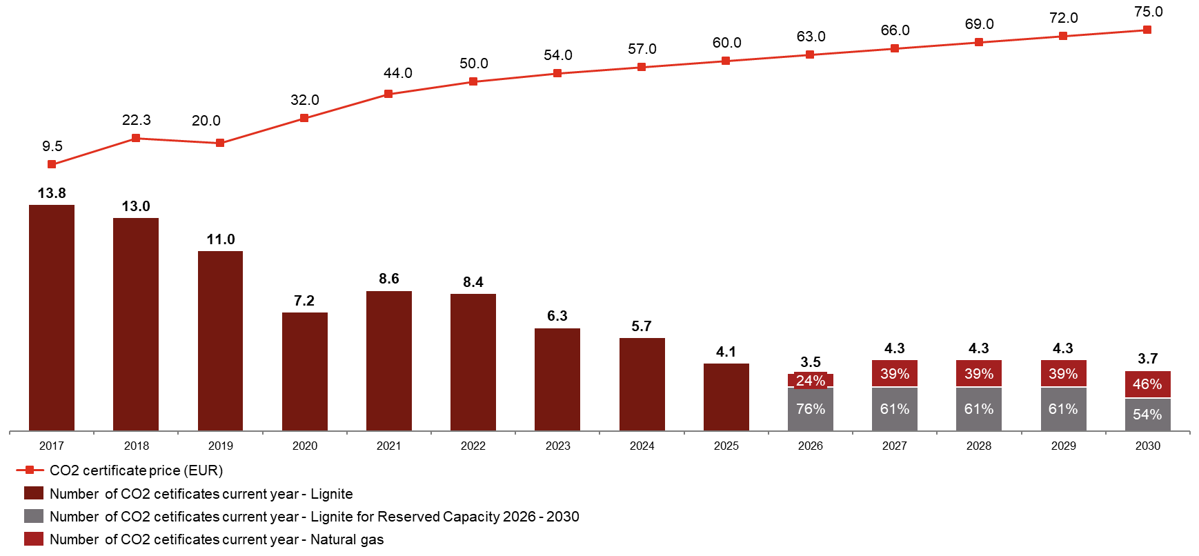
The Restructuring Plan introduces a holding structure with different legal entities corresponding to the existing and new lines of business
Restructuring period 2021 - 2026
Lignite subsidiary 2026-2030
The State aid supports the existing activities as well as the development of the New Projects/Business
The business plan targets a neutral cash flow position during the period
will incorporate the lignite assets which will be operated under a Capacity Reserve logic (either at TSO request or only if it can support itself under given market conditions) for max 3TWh/y
Any compensation mechanism would be provided by the Phase-out Law with the aim of neutralizing any negative impact on CE Oltenia
New Business 2027-2030
will incorporate the new assets where each project will be placed in a different legal entity (SPV)
projected profitability and cash flow generation of the New Business will support the restoration of CE Oltenia’s viability
Cumulative cash flow in excess of EUR 200 million
ROCE in excess of 7%
Emissions reduction: from 14 million tons to ~4 million tons (if the Reserved Capacity will be used in full)

Slide 8
SPVs process led to the selection of two private investors as future partners for 9 out 10 projects. For the last project the process is ready to be relaunched
TINMAR ENERGY SA
The largest private supplier of electricity, natural gas and oil products, production of electricity
Active in 21 countries, 5 European offices, 2800 corporate clients
Owns 13 PV projects with 75 MW installed capacity and they plan to grow further their portfolio
Selected bidder for 4 PVs and CCGT Turceni, 55% stake and a EUR 35 million equity commitment at SPV establishment
OMV PETROM SA
Integrated oil, gas, energy company; part of OMV group (AT)
One of the largest companies in Romania with international activities
Owns and operates a 860 MW CCGT and plans to invest in 1 GW of renewable energy
Selected bidder for 4 PVs, 50% stake and a EUR 75 million equity commitment at SPV establishment
Project type | MW installed | CAPEX | Modernisation Fund | Bank Financing | Equity/SH loan
PV | 735 | 670,802,000 | 469,561,400 | 93,550,410 | 107,690,190
 |  |  | 70% | 14% | 16%
CCGT | 1,325 | 841,261,000 | 420,630,500 | 260,940,350 | 159,690,150
 |  |  | 50% | 31% | 19%
Grand total | 2,060 | 1,512,063,000 | 890,191,900 | 354,490,760 | 267,380,340

Slide 9
SPVs process – Calendar
Stage | Deadline
Preparation of the initial draft of the Shareholders' Agreement | December 2021
2. Negotiating the transaction documents with the selected investors and discussing their final form | January 14, 2022 - February 25, 2022
3. CSAT Transaction Presentation Pre-notification | February 10, 2022
4. Final (revised) form of Transaction Documents | February 28, 2022
5. Approval of Transaction Documents by the Management and CS CEO | March 1, 2022- EB approval March 4, 2022- SB approval
6. CEO: Approval of the EGMS of the final documents of the Transaction and granting the mandate for their signing | April 7, 2022
7. Investor: Approval of the GMS of the final documents of the Transaction and granting the mandate for their signing | April 7, 2022
8. Signing of the transaction documents by the representatives of CE Oltenia and Investitor | April 8, 2022
9. Notification of the Competition Council in order to obtain a non-objection decision on the concentration | April 8, 2022
10. Obtaining the non-objection decision on the concentration | June 8, 2022
11. Completion of the transaction | June 9, 2022
12. Registration of SPVs at the competent Trade Register Office | June 24, 2022

Slide 10

Bank financing EBRD
Index | Milestone | 2021 |  |  | 2022
 |  | Oct | Nov | Dec | Ian | Feb | Mar | Apr | May | Jun | Jul | Aug | Sept | Oct | Nov
1 | Mandating BERD
2 | Due diligence procedure
3 | Heads of Terms
4 | List of banks
5 | Approval of the Restructuring Plan
6 | Approval of the Modernisation Fund
8 | Revalidation of banks appetite
10 | Binding Terms sheet
12 | Internal approvals
14 | Loan Agreement
15 | Approval of Credit Contracts, guarantees, etc
27 Jan
7 Apr

Slide 11
Modernisation Fund Financing
Modernisation Fund:
  For non-priority investments (CCGTs project Isalnita and Turceni) the application was submitted formally on January 27th
  For non-priority investments (PVs projects) the applications will be submitted until February 24th
  Investment Committee is scheduled on April 7th
Project No | Project title | TOTAL CAPEX [EUR] | CAPEX from MF [EUR] | MF [%]
1 | Construction of a Natural Gas-Fired Combined Cycle Power Unit of approx. 850 MW Isalnita | 506.251.000 | 253.125.500 | 50%
2 | Construction of a Natural Gas-Fired Combined Cycle Power Unit of approx. 475 MW at Turceni | 335.010.000 | 167.505.000 | 50%
3 | Construction of a Photovoltaic Park with an installed power of approx. 83 MW on the ash and slag closed deposits of Rovinari | 73.126.000 | 51.188.200 | 70%
4 | Construction of a Photovoltaic Park with an installed power of approx. 85 MW on the ash and slag closed deposits of Isalnita | 76.331.000 | 53.431.700 | 70%
5 | Construction of a Photovoltaic Park with an installed power of approx. 112 MW on the ash and slag closed deposits of Turceni | 100.582.000 | 70.407.400 | 70%
6 | Construction of a Photovoltaic Park with an installed power of approx. 110 MW on Rovinari-Est Inner Waste Pile | 104.090.000 | 72.863.000 | 70%
7 | Construction of a Photovoltaic Park with an installed power of approx. 128 MW on the inner waste pile within Tismana 1 – Rosia-Rovinari Open Pit Mining Unit | 114.406.000 | 80.084.200 | 70%
8 | Construction of Photovoltaic Park with an installed power of approx. 132 MW on Tismana 2 Inner Waste Pile – Rosia – Rovinari Open Pit Mining Unit | 115.358.000 | 80.750.600 | 70%
9 | Construction of a Photovoltaic Park with an installed power of approx. 66 MW on Pinoasa Waste Pile – Pinoasa Open Pit Mining Unit | 68.432.000 | 47.902.400 | 70%
10 | Construction of a Photovoltaic Park with an installed power of approx. 19 MW on Bohorelu Waste Pile | 18.477.000 | 12.933.900 | 70%
11 | Rehabilitation and modernization of micro hydropower plant with an installed capacity of 9.9 MW Turceni | 10.256.000 | 5.128.000 | 50%
TOTAL |  | 1.522.319.000 | 895.319.900 | 59%

Slide 12
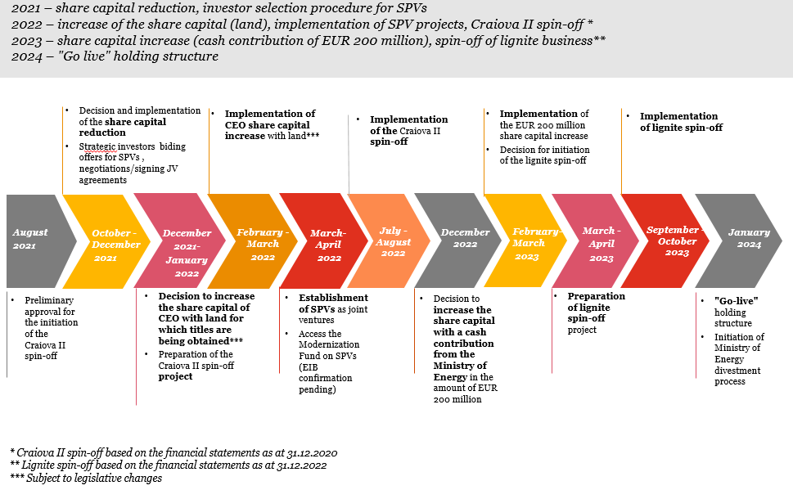
Share capital & reorganization operations/ State divestment
Romanian state will divest no less than 20% of its shareholding in CE Oltenia by 31 December 2026.

Slide 13
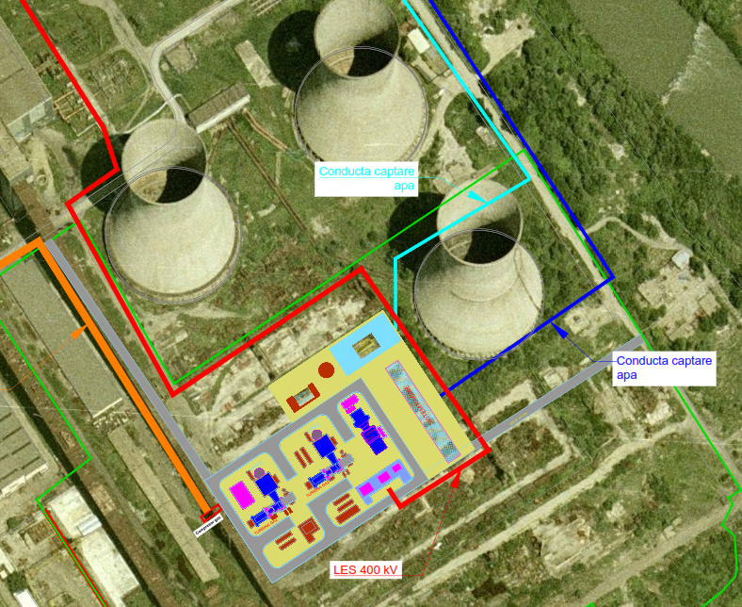
The development of a 475 MW natural gas CCGT Turceni
Project technical description
In the south-east section of Turceni, at about 1 km distance from the city. The available surface is approx. 123,000 sqm
The proposed gas-steam combined cycle (CCGT) energy system uses a combination of 1 TG (gas turbine) + 1 HRSG (recovery boiler) + 1 TA (steam turbine), single shaft (1 generator)
Feasibility study developed by SC Energobit Control Systems SRL in September 2020
Investment life = 25 years
Start date of the investment: 2021
The total implementation duration of the investment objective is 64 months, of which the execution duration is 54 months
Project description
Technical description
The objectives to be achieved by implementing the investment are:
installed electrical power between 350-475 MWe;
Greenhouse gas emissions = 0.335 tCO2 / MWh
the net efficiency of the energy group, CCGT, at nominal power will be at least 57%;
the energy group will be dispatchable and will be able to provide system technological services (STS), all voltage and power settings, including reactive power, conditioned by Transelectrica through DEN (national energy dispatcher);
flexibility: 50% and 100% of the load
The natural gas supply will be ensured by:
a high pressure natural gas transmission connection with nominal diameter DN 500, nominal pressure PN40, and a length of 0.10 km, which will be connected to the existing pipe
a Delivery Measurement Regulation Station (SRMP) with technological capacity Q = 80,000 m3 / h, which will be located on a privately owned land of Turceni Power Plant Branch.
The power produced by the CCGT electric generators will be discharged into the NES through a power-raising transformer at a voltage of 400 kV will be connected in the 400kV OHL to the 400kV Tânțăreni station in the cell of the former disbanded G8 group.

Slide 14
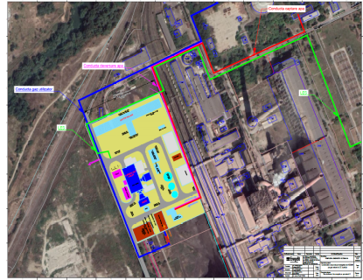
The development of a 850 MW natural gas CCGT Isalnita
Project technical description
Within TPP Işalniţa which is located in the north-western part of Craiova, at a distance of 11 km, on an industrial platform near Ișalnița commune, the available area is approx. 124,000 sqm
The proposed gas-steam combined cycle (CCGT) energy system uses a combination of 1 TG (gas turbine) + 1 HRSG (recovery boiler) + 1 TA (steam turbine), multi-shaft (2 generators)
Feasibility study developed by SC Energobit Control Systems SRL in September 2020
Investment life = 25 years
Start date of the investment: 2021
The total implementation duration of the investment objective is 64 months, of which the execution duration is 54 months
Project description
Technical description
The objectives to be achieved by implementing the investment are:
installed electrical power between 690-850 MWe
Greenhouse gas emissions = 0.325 tCO2 / MWh
the net efficiency of the energy group, CCGT, at nominal power will be at least 57% (according to BAT conclusions);
the energy group will be dispatchable and will be able to provide system technological services (STS), all voltage and power settings, including reactive power, conditioned by Transelectrica through DEN (national energy dispatcher);
flexibility: 50% and 100% of the load.
The natural gas supply will be ensured by:
a high pressure connection DN 500, PN 40, Q = 120000 m3 / h, from steel pipe, mounted underground, from Wire III Transgaz, Turburea-Ișalnița, L = 800 m
a SRMP Q = 120,000 m3 / h, located inside Ișalnița Power Plant Branch, as close as possible to the property limit, with the possibility of connection to electricity and access road
The power produced by the electric generators of CCGT will be evacuated in NES through the 220kV Ișalnița - Slatina line, a line that is currently under conservation, being necessary to reactivate this line

Slide 15
CEO CCGTs → Romania coal phase-out
The energy sector remains the main source of greenhouse gas emissions (GHG) with 66% of emissions belonging to this sector. Given the current energy mix, even with the targets in the Integrated National Energy and Climate Plan (INECP), Romania needs additional actions to meet the emission reduction targets for 2030.
In addition to increasing the share of energy from renewable sources, another strategic objective refers to the replacement of coal in the energy mix that should aim at maintaining the stability of the National Power System and ensuring the Romania’s power need.
This coal phase-out process requires the commissioning of some new capacities with low emissions and it should contribute to the flexibility of the power system for a high increase of the renewable energy sources.
In order to replace rapidly coal-fired capacities, the natural gas should have a key role – also in combination with hydrogen on mid to long term horizon - to support the national decarbonisation objectives and in accordance with the specific country recommendations
CCGT Isalnita benefits
CCGT Turceni benefits
Total reductions in CO2 emissions: ~ 3.045 kt CO2 / year (~ 10% of the objective of the Integrated National Energy and Climate Plan)
Primary energy saved: ~ 642,500 Toe / year (~ 2.5% of the objective of the Integrated National Energy and Climate Plan)
CAPEX efficiency: EUR 506 million or 596 ths eur/MW lower than industry benchmark
Trigger/support for an additional RES installed capacity around : ~ 330 MW for wind or ~566 MW for PV
Hydrogen readiness
Direct jobs created: 80 jobs
Jobs during construction: 300-400 / year, with a peak of about 1000 people during the five years of project execution
Total reductions in CO2 emissions: ~1,672 kt CO2/year (~5.4 % of the objective of the Integrated National Energy and Climate Plan)
Primary energy saved: ~ 337,716 Toe/year (~ 1.3 % of the objective of the Integrated National Energy and Climate Plan)
CAPEX efficiency: EUR 335 million or 705 ths eur/MW lower than industry benchmark
Trigger/support for an additional RES installed capacity around: ~ 369 MW for wind or ~633 MW for PV
Hydrogen readiness
Direct jobs created: 80 jobs
Jobs during construction: 300-400 / year, with a peak of about 1000 people during the five years of project execution

Slide 16
CCGT Isalnita M&A timeline and Financing syndication
 | Steps | February | March | April |  | May | June | July | August | September
1 | Publishing of the binding phase announcements
2 | Non-binding Offers from potential investors
3 | Non-binding Offers analisys
4 | Specifications book acquisition
5 | Binding Offers from potential investors
6 | Investor selection
CCGTs financing syndication:
The financing for the CCGT projects will be raised with Erste/BCR and Black Sea Trade and Development Bank (BSTDB) acting as co-leaders of the syndicate
Based on the information package sent by CE Oltenia to the interested banks, BSTDB and the 8 commercial banks provided the terms and conditions: ticket, pricing, repayment period, grace period, permitting and future contracts, off-take, etc
Total ticket: ~ EUR 250 million expected to increase
The projects were assessed from the ESG perspective by Raiffeisen Bank and found in line with bank’s respective policy
Next steps: mandate letter for the two co-leaders of the syndicate mid of March , binding terms sheet June/July

Slide 17
Thank you

