Slide 1
Industrial Heat Pump
Portfolio Presentation
Septembrie 2022

Slide 2
Agenda
1
Our mission
Decarbonization of heat
2
Our portfolio
Large-scale Heat Pumps
3
Our use cases
4
Our references
e.g., Stockholm

Slide 3

Industrial
Heat Pump
a way to decarbonize the heat sector and improving efficiency
for the transition into a more environmentally friendly solution and sustainable world
Heat Pumps

Slide 4
Today – Decarbonization is urgent
Heat in Europe is still largely produced from fossil sources
Final energy consumption EU28
Heating and cooling in EU28 by carrier
District heating
Electricity (direct)
Transport and other
Heat pumps (electricity)
Solar thermal
1%
Biomass
1%
Oil
6%
Heating and cooling
Coal
Electricity
~12,600
TWh (2015)
Gas
~6,300
TWh (2015)
4%
other fossil
50%
2/3 heat
Decarbonizing the heat sector requires
Efficiency improvements
(e.g., thermal insulation, use of waste heat)
Replacement of fossil fuels with renewables
or renewable power
of final energy use is heat → more than double comparing electricity
is produced from fossil fuels → ~40% of energy related CO₂ emissions

Slide 5
Agenda
1
Our mission
Decarbonization of heat
2
Our portfolio
Large-scale Heat Pumps
3
Our use cases
4
Our references
e.g., Stockholm

Slide 6
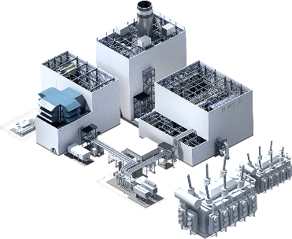
Generation
We offer a broad portfolio of products, solutions and services for central and distributed power generation. Our product portfolio comprises gas and steam turbines, generators and gas engines as well as instrumentation & controls and electrical systems.
A comprehensive set of services covering performance enhancements, maintenance services, customer training and professional consulting complement its products and solutions businesses.
siemens-energy.com/generation
Positioning
A market leader with strong global presence, high customer intimacy and highly competitive portfolio.
Service
Resilient service business with strong backlog, attractive profitability and a growing fleet.
Energy transition
Driving the energy transition by distributed offering and innovations in decarbonized energy systems and digital.
Value
Value generation by cost-
out programs, footprint consolidation, portfolio streamlining and focus
on service and distributed.

Slide 7
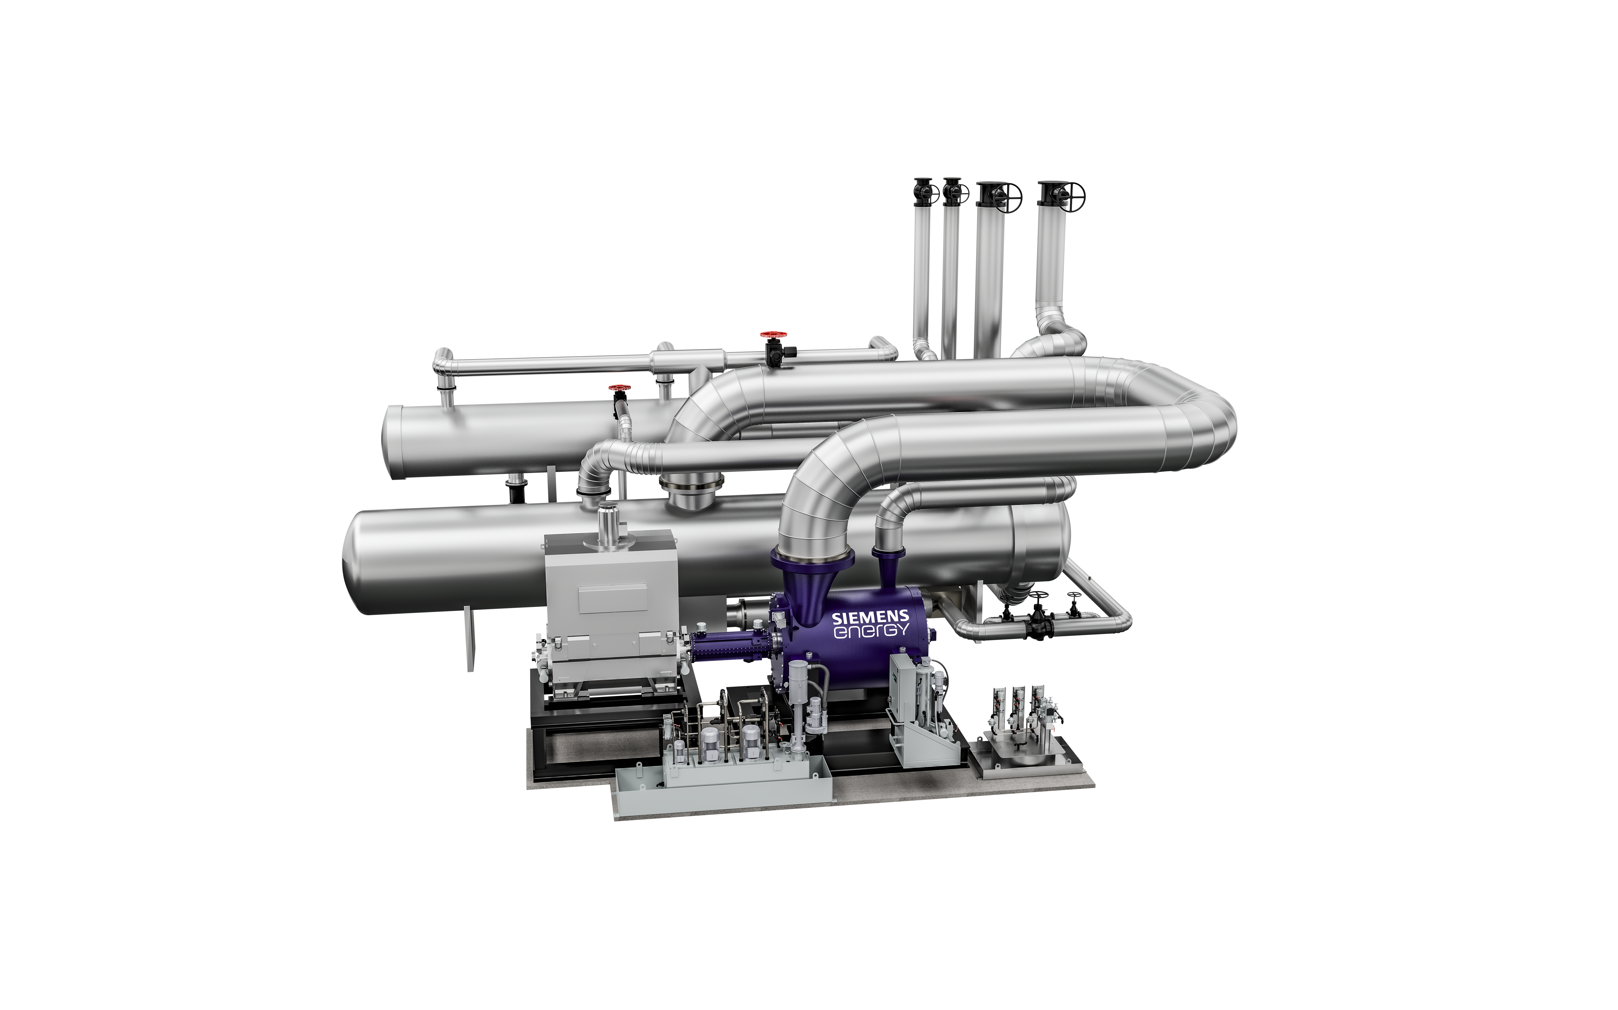




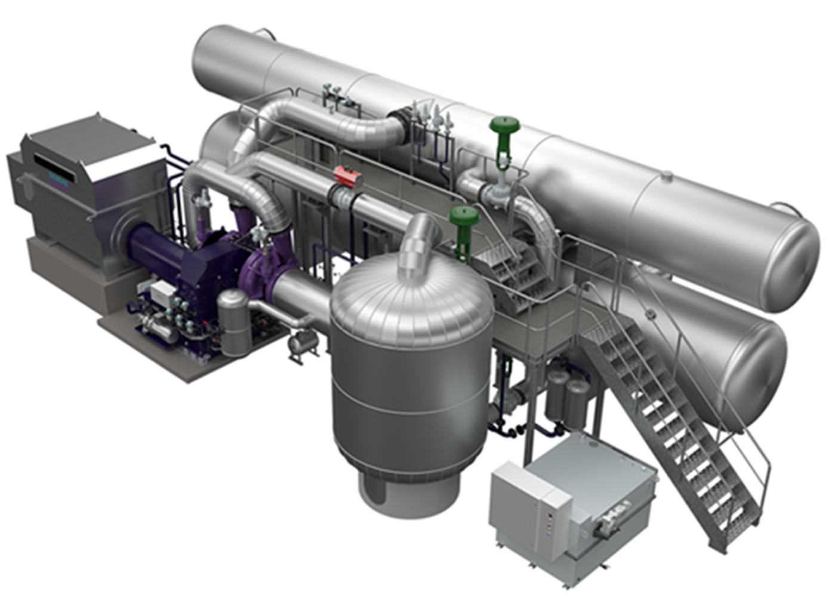
Industrial scale Heat Pumps from Siemens Energy address both district heating and industry applications
Two Complementary Product Lines …
… To Serve the Needs of our Customers
SHP-STC-XX W/S
High Temperature Heat Pump
5 – 70 MW, Up to 150 °C (Hot Water OR STEAM)
Heat supply
~5 - 70MW_{th} per unit
temperatures
up to 150°C directly from heat pump
Environment friendly Work medium
low GWP and ODP
SHP-C600
Based on PROVEN design (since 1980_{s})
15 – 45 MW, up to 100 °C (Hot Water)
Various Drive Concepts
electrical or mechanical
Combination with Steam Compression
for higher temperatures and pressures for process steam production
Scope of supply
component up to turnkey supply

Slide 8

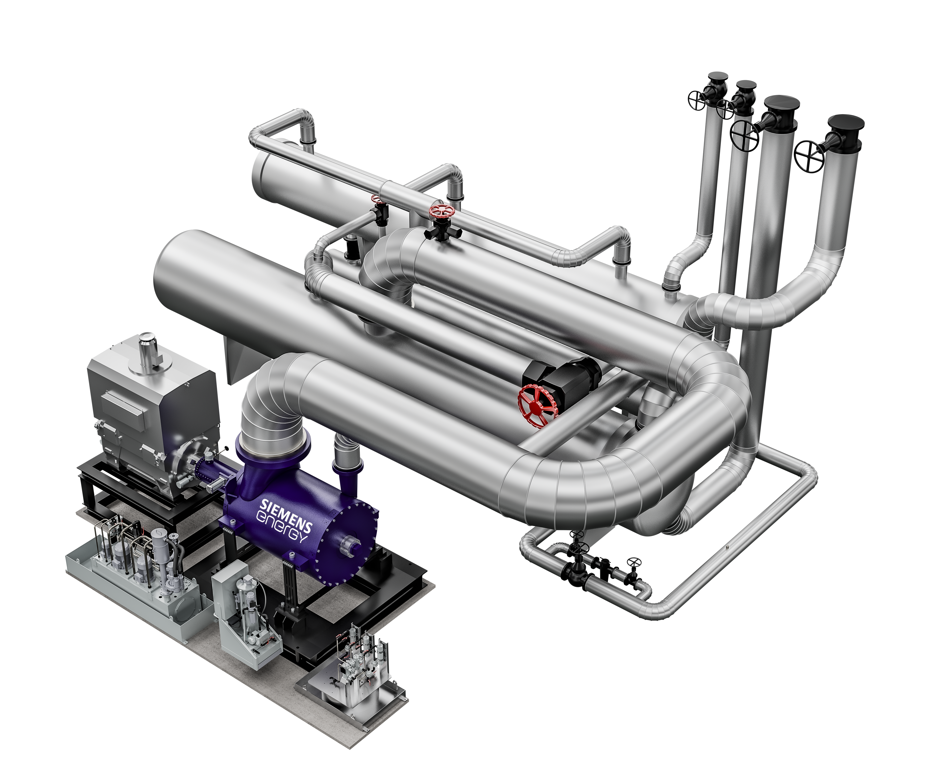
Siemens Energy is delivering this new type
of large-scale, high-temperature heat pump
to provide thermal capacity of up to 70 MWth,
which will be capable of flexibly delivering
flow temperatures e.g., in the district heating
network. This is one way in which technology
can make a further contribution toward
replacing fossil-based heating in urban
district heating networks.
Outstanding performance
High flexibility
Proven technology based on > 2.100
compressors delivered since 1948
up to 150 °C
Technical
data sheet
References
REFERENCE QWARK³ PROJECT, VATTENFALL, BERLIN, GERMANY | 2022
SHP-STC-XX W/S
High temperature heat pump​
Heat generation
Heat supply 5 – 70 MWth
Temperatures up to 150 °C (hot water or steam)
​

Slide 9
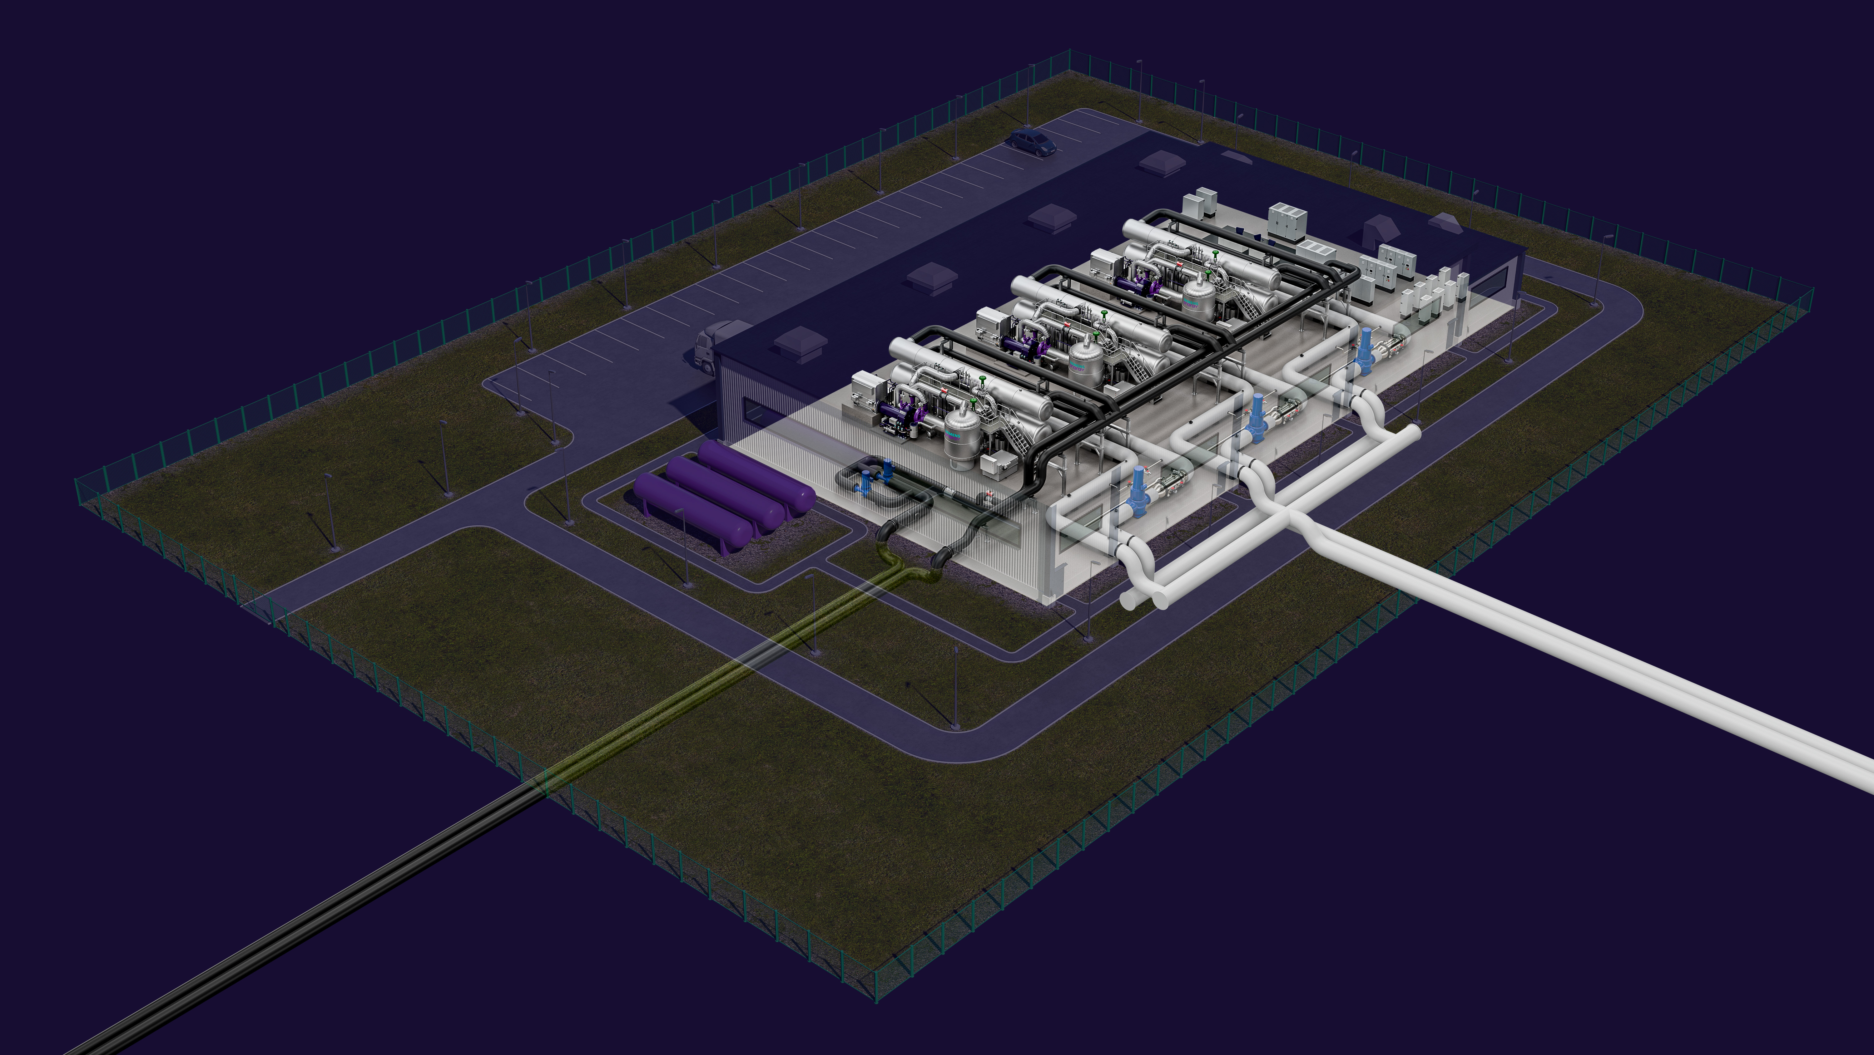
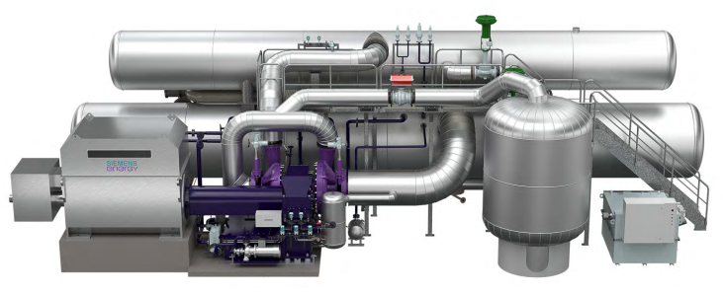
Siemens Energy is delivering this updated type
of large-scale, low-temperature heat pump
to provide thermal capacity of up to 45 MWth
which will be capable of flexibly delivering
flow temperatures e.g., in the district heating
network up to 100 °C.
With the existing fleet Siemens Energy has over
the years truly proven the robustness of the
heavy-duty industrial heat pump. The design is
based on over 50 deliveries, starting in mid 80s,
with more then 6 millions accumulated operating
hours.
Outstanding performance
Operational flexibility
Deep knowledge-based heat pump
Flexible modularized concept
Technical
data sheet
References
REFERENCE EXERGI PROJECT, STOCKHOLM, SWEDEN | 2020
SHP-C600
Low temperature heat pump​
Heat generation
Heat supply 15 – 45 MWth
Temperatures up to 100 °C (hot water or steam)
​
up to 100 °C

Slide 10
Agenda
1
Our mission
Decarbonization of heat
2
Our portfolio
Large-scale Heat Pumps
3
Our use cases
4
Our references
e.g., Stockholm

Slide 11
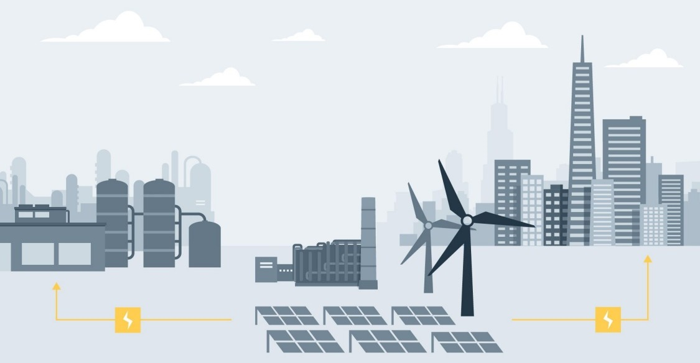
Market Need for Large Scale
Industrial Heat Pumps
Energy market
is changing with a continuous increase
of renewable energy whilst heat from
combustible applications becoming less.
This at the same time as the need
for heat is increasing.
Heat Pump
One part of electrical energy for driving the heat pump and about three parts of heat energy extracted from a low temperature heat source can produce up to four¹ parts of useful heat.
Electricity
from wind-, solar- and hydro power need to be converted into heat. Industrial scale heat pumps is both economic and environmentally friendly and will play an important role on the future energy market.
Heat Source examples
Incineration plants
Industrial waste heat
Raw sewage or treated sewage
Sea, lake or river
Geothermal
Thermal Reservoir
Server Hall
Heat Source
1 Note: Performance depends on specific site conditions
2020-12-18
Notes:
Heat is almost 50% of the total final energy consumption worldwide.
Traditionally heat has been generated from combusting fossil fuels or waste heat.
Decarbonization targets drives the heating sector to look for alternatives to fossil fired heating plants which is a perfect match for electrical driven heat pumps.
Today the energy market is changing with a continuous increase of renewable energy sources and less waste heat available from combustible applications.
Electricity from wind-, solar- and hydro power need to be converted into heat which is where the heat pump application will come in to play on the future energy market.
The heat pump principle can be simplified as follows: One part of electrical energy for driving the heat pump
compressor motor and about three parts of heat energy extracted from a low temperature heat source (e.g.
lake, sea, air, waste heat or geothermal) can produce around four parts of useful heat. (note. Performance depends on specific site conditions).
A heat pump application will be much more environmentally friendly than traditional heat producers as the heat pump application will only consume electricity and not release any CO2, sulphur dioxide or other pollution to the environment. The new modern refrigerant used has an extremely low Global Warming Potential in comparison to other refrigerants.

Slide 12
Decentralized District Heating
Historically fired heat plants naturally deliver high
district heating temperature and district heating network traditionally run with high temperatures accordingly.
Industry and Process
DH high temp. req.
Domestic Heating
DH low temp. Req.
Instead locate heat pumps close to heat sources
such as sewage, server halls or other facilities that
have available waste heat.
Heat Source:
Data Centers
Solar Power
Create a win-win where a cooling application is required.
Decentralized
Heat Pumps
Decentralized
Heat Pumps
Domestic heating do not require as high
temperatures as industries or processes.
Heat Source:
Sewage water
Geothermal
Sea/lake/river
The SHP-C600 is an excellent fit for decentralized
heat pump applications.
Wind Power
2020-12-18

Slide 13

Industrial Heat Pumps @ Industry
Production of useful heat to District Heating from District Cooling Network
Situation Today
Improved situation with heat pump
60 ˚C
District Heating Network
60 ˚C
District Heating Network
Heat Pump
Fossil
Fuel
Boiler
95 ˚C
95 ˚C
Cooling Facility
z.B. Cooling Tower, ACC
District Cooling Network
District Cooling Network
15 ˚C
5 ˚C
Benefits
District Heating heat supply with reduced CO2 emissions
Less dependency on fossil fuels
Use waste heat from Colling source
Reduced cooling demand → no additional cooling facilities needed anymore → e.g. reduction of aux. consumption, make-up water

Slide 14
Industrial Heat Pumps @ District Heating & Industry
Integration of large cooling systems / utilization of new heat sources
Situation Today
Improved situation with heat pump
Cooling Facility
z.B. Cooling Tower, ACC
Heat Pump
Large Commercial Building, Data Center
Industrial Plant
Large Commercial Building, Data Center
Industrial Plant
District Heating Network
60 ˚C
District Heating Network
110 ˚C
110 ˚C
60 ˚C
60 ˚C
Benefits
Waste heat from large commercial buildings, data centers and industry can be utilized for district heating → opening up new sources for district heating
Combined-Heat-and-Power-and-Cooling → re-use of waste heat → reduced heat rejection to ambience
no additional cooling facilities needed anymore → e.g. reduction of aux. consumption, make-up water
“cooling” as additional product for heat pumps

Slide 15
Integration of Industrial Heat Pump – Project Example
Heating and cooling facility at Potsdamer Platz | Overview & key figures
Overview
Key Figures
Cooling Network
60°C
Capacity | 1 Unit ~8 MWth,
Average COP | ~3
Refrigerant | Hydro-(-chloro)-fluoro-olefin (H(C)FO)
Arrangement | Brownfield (integration in existing building)
Heat source | Cooling water return from compression chillers to wet cell cooling tower (32 → 27 °C)
Heat sink | District heating (50 → 85 - 128°C)
Compressor | SIEMENS single shaft centrifugal vertically split radial compressor
Lube & Seal Oil System | Combined lube and Seal Oil System
Heat Exchanger | Semi-welded Plate Type Heat Exchangers (Evaporator, Condenser, Subcooler)
I&C System | T3000 compact
CHP plant
6°C
12°C
85 - 128°C
District Heating
Chiller
32°C
Heat Pump
27°C
Cooling Towers
Background
Heat pump lifts the temperature level of cooling water from chillers to the temperature level of the district heating system
Public funded project (BMWi) in cooperation with Vattenfall Wärme Berlin

Slide 16
Integration of Industrial Heat Pump – Project Example
Process Steam Production in chemical plant | Overview & key figures
Overview
Key Figures
Feedwater
20 °C
Process Steam
19 bara, 240 °C
Capacity | 36 MWth HP & Steam Compressor = 50 MWth
Average COP | ~ 2.5 (incl. steam compression)
Refrigerant | Hydro-(-chloro)-fluoro-olefin (H(C)FO)
Arrangement | Brownfield (integration in existing building)
Heat source | Process water return from reactors (90 → 70 °C)
Heat sink | Process Steam (20 °C → 19 bara, 240 °C)
Compressor | SIEMENS geared type radial compressor
Lube & Seal Oil System | Combined lube and Seal Oil System
Heat Exchanger | Shell & Tube Heat Exchangers (Evaporator, Condenser, Subcooler)
I&C System | T3000 compact
Steam Compressor
Heat Pump
Process Water
90 °C
Background
High temperature heat pump utilizes waste heat from process water of reactors to produce saturated steam from feedwater
Saturated steam is fed to steam compressor (multi-stage intercooled / attemporated)
Final adjustment of steam parameters by attemporation

Slide 17
Concept – Waste Heat Utilization for Electrolysers
Heat Pump for cooling & supply of process heat (hot water)
Process Flow Scheme
Principle
Heat Pump absorbs the heat from the H2 production and lifts it to higher temperature level e.g. for process heating (hot water or steam)
from heat consumers
Challenges
Heat demand and waste heat from H2 production may timewise not be congruent
Fluctuating heat from H2 production (esp. when driven be renewable electricity)
to heat consumers
PEM
Electrolyseur
thermal storage
(hot)
thermal storage (cold)
Concept
Decoupling of waste heat production and heat demand by thermal storage
Optimized sizing of heat pump by integrating a thermal waste heat storage for electrolyzers
heat pump
H2
Compressor
O2
Compressor
… other heat sources
closed cooling water system
Back-Up / excess cooler

Slide 18
Agenda
1
Our mission
Decarbonization of heat
2
Our portfolio
Large-scale Heat Pumps
4
Our references
e.g., Stockholm
3
Our use cases

Slide 19


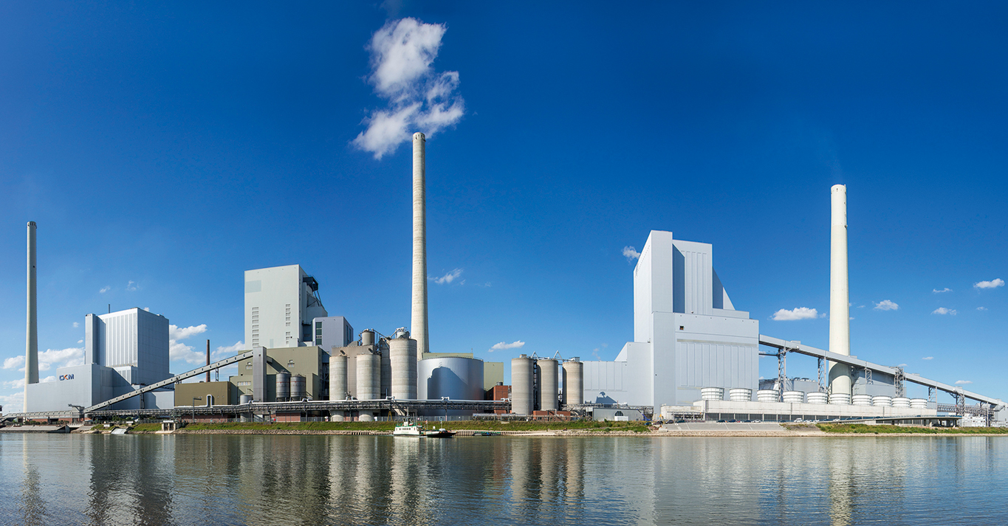
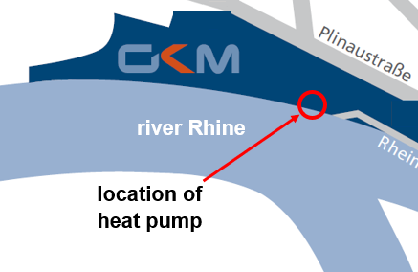
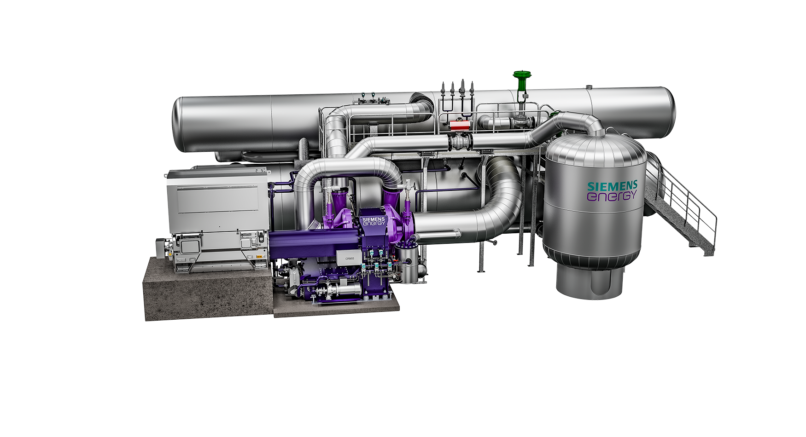





Siemens Energy and MVV with GKM using a large-scale heat pump to do the first step towards green district heating
REFERENCE MVV & GKM MANNHEIM, GERMANY | 2021
Press release together with GKM / MVV will come in March 2022
Deep Decarbonization
Press release
Customer Challenge/Driver
  Decrease the use of coal at GKM power plant by installation of a heat pump using the river as energy source. The new heat pump is the first step towards the goal of green district heating. MVV and the City of Mannheim is targeting to become CO₂ neutral in the district heating production by 2030.
> 10,000
tons CO₂/a
savings
Portfolio Elements
  Low temperature heat pump SHP-C600 from Finspang (20 MW_{th}) enabling temperature levels up to 99 °C, compressor with gear, electrical motor, heat exchangers, storage tank & control system
Scope
  Delivery of a complete heat pump SHP-C600 including full installation and commissioning
Customer Benefit
  Decrease the use of coal
  Use the river Rhine as heat source
  Provide 50 GWh/a heat for the district heating network
  More than 10,000 t of CO₂ emissions savings per year
  versus heat from a gas boiler at 2,500 full operating hours
PROJECT TYPE
Heat & Green
Municipalities
Efficiency
CO₂-savings

Slide 20



Vattenfall and Siemens Energy help advance a climate-friendly heating supply for Berlin with large scale heat pump
REFERENCE QWARK³ PROJECT, VATTENFALL, BERLIN | MARCH 2021
Press release
Deep decarbonization
Press release
6’500
tons CO2
savings
Customer Challenge/Driver
Utilize unused waste-heat of district cooling as heat source for district heating
Portfolio Elements
  High-temperature heat pump (8 MW_{th}) enabling
  temperature levels from 85 to 120 °C
Scope
  Our role: Provide new large scale heat pump technology
  Partner: Vattenfall Wärme Berlin
Customer Benefit
  Avoid unused heat being dissipated into the environment
  Provide 55 GWh/a additional heat for the district heating network
  6,500 t of CO₂ emissions savings
  120,000 m³ of cooling water savings
PROJECT TYPE
Heat & Green
Municipalities
Efficiency
CO₂-savings

Slide 21
Integration of Industrial Heat Pump – Project Example
Heating and cooling facility at Potsdamer Platz | Overview & key figures
Overview
Key Figures
Cooling Network
60°C
Capacity | 1 Unit ~8 MWth,
Average COP | ~3
Refrigerant | Hydro-(-chloro)-fluoro-olefin (H(C)FO)
Arrangement | Brownfield (integration in existing building)
Heat source | Cooling water return from compression chillers to wet cell cooling tower (32 → 27 °C)
Heat sink | District heating (50 → 85 - 128°C)
Compressor | SIEMENS single shaft centrifugal vertically split radial compressor
Lube & Seal Oil System | Combined lube and Seal Oil System
Heat Exchanger | Semi-welded Plate Type Heat Exchangers (Evaporator, Condenser, Subcooler)
I&C System | T3000 compact
CHP plant
6°C
12°C
85 - 128°C
District Heating
Chiller
32°C
Heat Pump
27°C
Cooling Towers
Background
Heat pump lifts the temperature level of cooling water from chillers to the temperature level of the district heating system
Public funded project (BMWi) in cooperation with Vattenfall Wärme Berlin

Slide 22
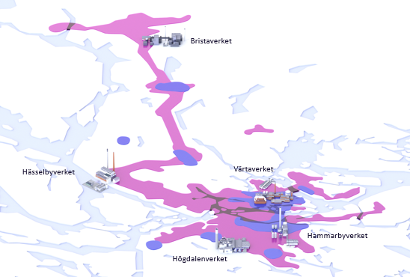
Siemens Energy is providing Stockholm with a climate neutral district heating and cooling supply
REFERENCE EXERGI PROJECT, STOCKHOLM, SWEDEN | 2020
Press release
Deep decarbonization
CO2
savings
Customer Challenge/Driver
  Carbon Neutral District Heating combined with District Cooling. Cooling operation flexibility during summer to operate with low heat demand for district heating.
Portfolio Elements
  Low-temperature heat pump plant solution ( from 20 MWth to 215 MWth) are located centralized and decentralized.
Scope
Heat Pumps optimized for each location and operational demand. Both Tube and Falling film evaporator to optimize performance to heat source temperature.
Customer Benefit
  Outstanding availability in operation since 1980s
  The compressor has been updated to meet new demands and increase efficiency
  Converted to new refrigerant
  Planned for operation for the next 20 years
  Reduced emissions compared to other heat power plants
PROJECT TYPE
Heat & Green
Municipalities
Efficiency
CO₂-savings

Slide 23
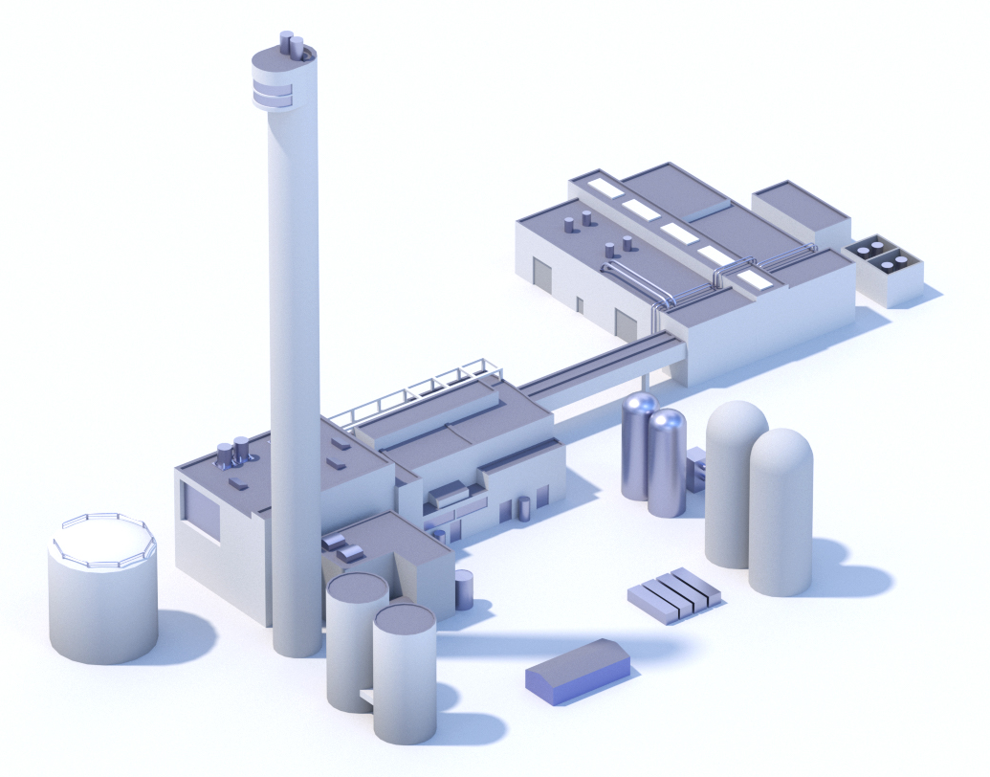
Hammarbyverket
Heats 80,000 apartments
Energy from purified waste water
Heat and cooling generated simultaneously
Plant | Fuel | Operational | Heating capacity
 |  |  | MW | GWh
7 heat pumps | Waste water, electricity | 1986-1991 | 215 | 900
2 boilers | Bio-oil | 1986 | 200 | 140
Total |  |  | 415 | 1 040
Notes:
OM PRESENTATIONSBILDEN. Inled om du vill berätta om Hammarbyverket. OBS! presentationsbilden är animerad med fyra ”klick” för de olika punkterna.
Sedan Hammarbyverket togs i drift 1986 har utsläppen av svaveloxid och stoft i luften över Södermalm minskat med två tredjedelar, mycket tack vare att många fastighetsägare gått över från individuell uppvärmning till fjärrvärme.
Anläggningen består av sju värmepumpar samt två biooljeeldade pannor och två elpannor som bara används när det är riktigt kallt vintertid. Värmepumparna producerar årligen över 1 200 GWh, vilket räcker för att värma 95 000 tvårumslägenheter en normalkall vinter.
Verket är världens största värmepumpsanläggning som hämtar värme ur renat avloppsvatten. Renat avloppsvatten kommer från Henriksdals reningsverk till Hammarbyverkets värmepumpar.
Med samma teknik produceras fjärrkyla ur det kalla vatten som är resultatet av värmeproduktionen. På så sätt utnyttjas energin maximalt – miljöanpassat och ekonomiskt. Det är ett varmt exempel på kretsloppstänkande och verket är en integrerad del av miljöstadsdelen Hammarby sjöstad.

Slide 24

Industrial Heat Pumps
References | since 1980
Nr. | Project | Heat Output | Nr. | Project | Heat Output
1 | Ludvika 1 | 11 MWth | 26 | Lund GEO | 20 MWth
2 | Västeras 1 | 12 MWth | 27 | KungsängenVP1 | 8 MWth
3 | Uppsala 1 | 13 MWth | 28 | Örebrö VP1 | 20 MWth
4 | Uppsala 2 | 13 MWth | 29 | Örebrö VP2 | 21 MWth
5 | Uppsala 3 | 13 MWth | 30 | Huskvarna | 7 MWth
6 | Visby | 12 MWth | 31 | Hammarby VP1 | 20 MWth
7 | Borlänge 1 | 12 MWth | 32 | Hammarby VP2 | 20 MWth
8 | Borlänge 2 | 12 MWth | 33 | Hammarby VP6 | 30 MWth
9 | Västeras 1 | 12 MWth | 34 | Hammarby VP7 | 30 MWth
10 | Lund1 | 13 MWth | 35 | Akersberga VP1 | 6 MWth
11 | Malmö1 | 13 MWth | 36 | Järfälla VP1 | 20 MWth
12 | Malmö2 | 13 MWth | 37 | Järfälla VP2 | 20 MWth
13 | Malmö3 | 13 MWth | 38 | Solna VP1 | 30 MWth
14 | Eskilstuna 1 | 13 MWth | 39 | Solna VP2 | 30 MWth
15 | Upplands Väsby 1 | 11 MWth | 40 | Solna VP3 | 30 MWth
16 | Upplands Väsby 2 | 11 MWth | 41 | Solna VP4 | 30 MWth
17 | Sandviken | 12 MWth | 42 | Lund Geo 2 | 27 MWth
18 | Gävle 1 | 14 MWth | 43 | Ropsten VP91 | 25 MWth
19 | Eskilstuna 2 | 13 MWth | 44 | Ropsten VP92 | 25 MWth
20 | Borlänge 3 | 12 MWth | 45 | Ropsten VP93 | 25 MWth
21 | Kalmar VP1 | 13 MWth | 46 | Ropsten VP94 | 25 MWth
22 | Örnsköldsvik VP1 | 14 MWth | 47 | Lindesberg VP1 | 5 MWth
23 | Örnsköldsvik VP2 | 5 MWth | 48 | Eslöv VP1 | 9 MWth
24 | Umea VP1 | 17 MWth | 49 | Jönköping | 25 MWth
25 | Umea VP2 | 17 MWth | 50 | Hammarby VP 5 | 30 MWth
Since 1980
50 Large Scale Heat Pumps from Siemens Energy

Slide 25

Contact overview – Siemens Energy Heat Pumps
Henrik Örn
Business Owner SHP-C600
Engineering
Phone +46 (122) 81000
Mobile +46 702735447
E-mail henrik.orn@siemens-energy.com
Dr. Christian Hüttl
Business Owner SHP-STC-XX W/S
Industrial Heat Pump Solution
Phone +49 (9131) 17-38099
Mobile +49 (172) 5213738
E-mail christian.huettl@siemens-energy.com
Mats Flenhagen
Senior Sales Manager
Generation Sales
Phone +46 12282956
Mobile +46 702495485
E-mail mats.flenhagen@siemens-energy.com
Norbert Wenn
Senior Sales Manager
Generation Sales Europe
Phone
Mobile +49 (152) 22524749
E-mail norbert.wenn@siemens-energy.com
Tanja Zusann
Senior Consultant DES
Generation Sales DES
Phone
Mobile +49 (172) 8338454
E-mail tanja.zusann@siemens-energy.com

Slide 26
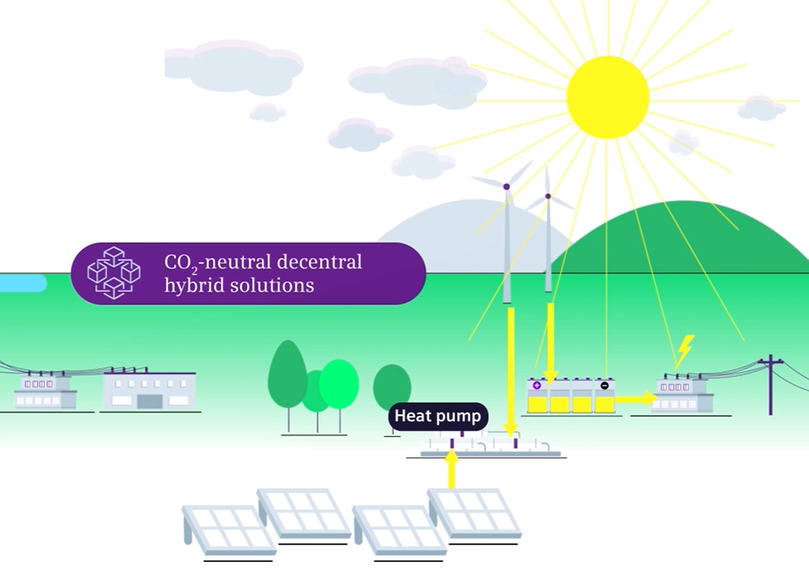
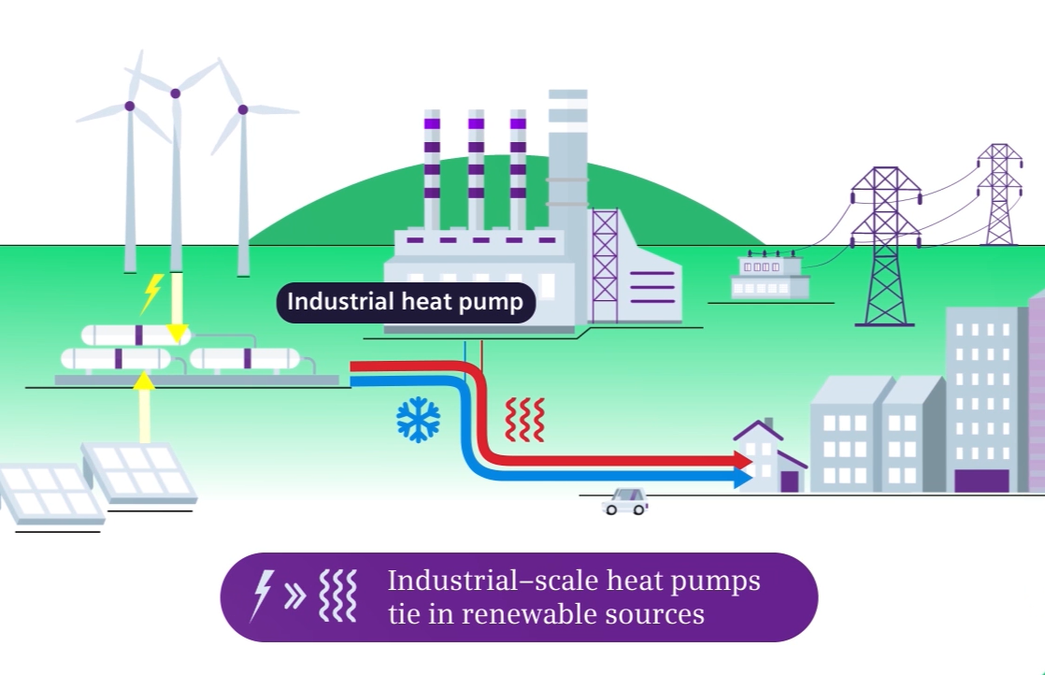
Decarbonization step by step with Siemens Energy
Heat Pumps play an essential role in decarbonization
https://www.stockholmexergi.se/fjarrvarme/sa-funkar-fjarrvarme/

Slide 27

Author | Department
27
Restricted © Siemens Energy, 2021

